Slide 1
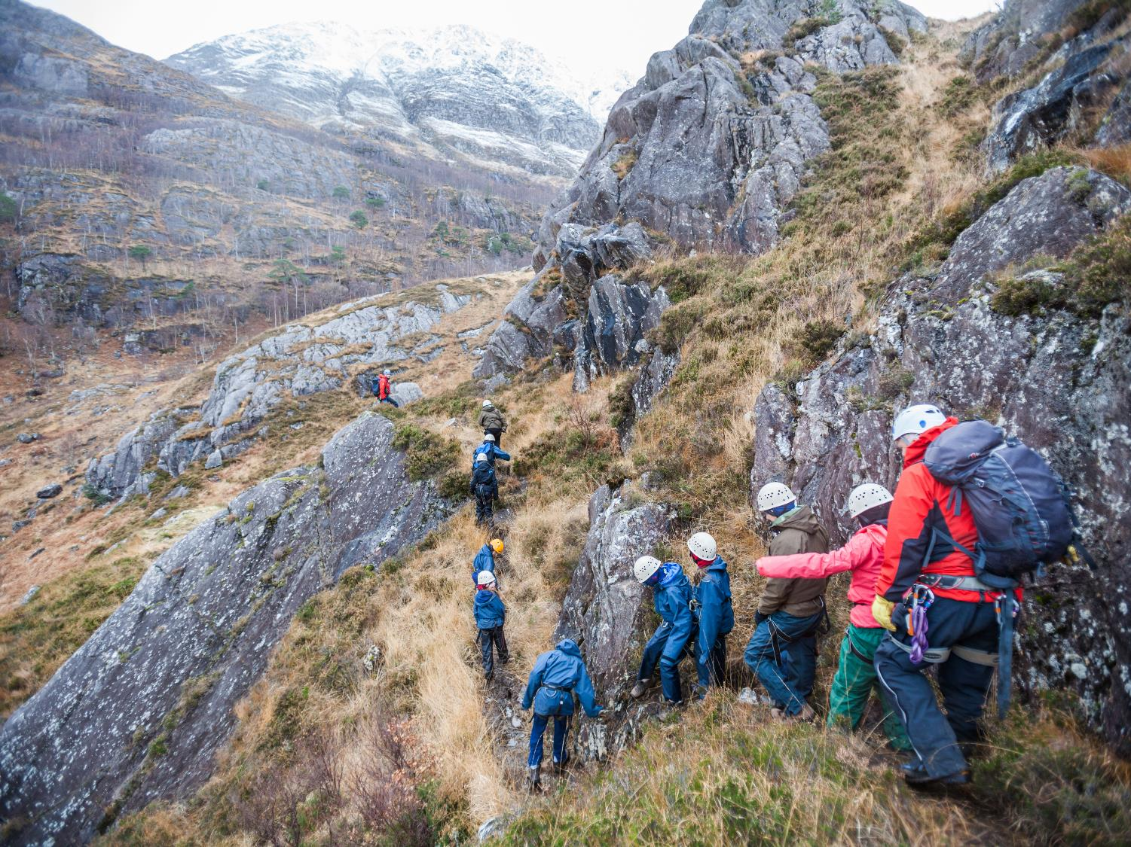
COURSE PROPOSAL
Transition Programme 2020
May 2019

Slide 2
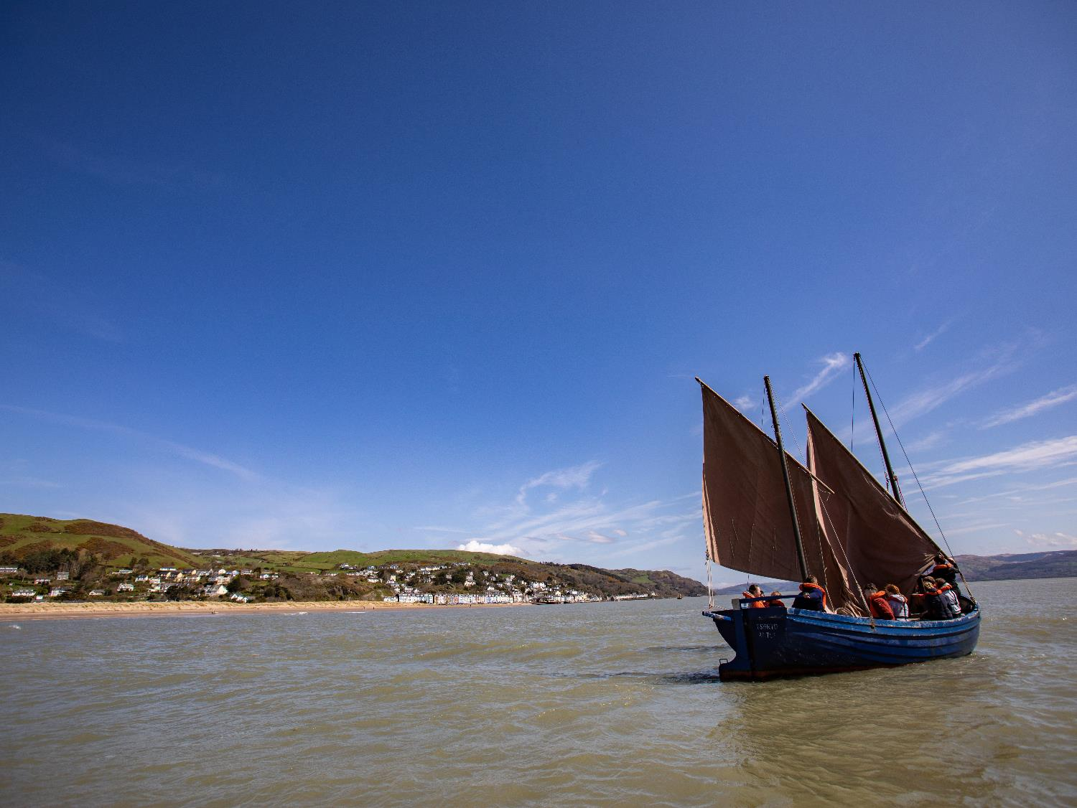
WELCOME
to
Outward bound
“
We are all better than we know. If only we can be brought to realise this, we may never again be prepared to settle for anything less.
“
Kurt Hahn

Slide 3
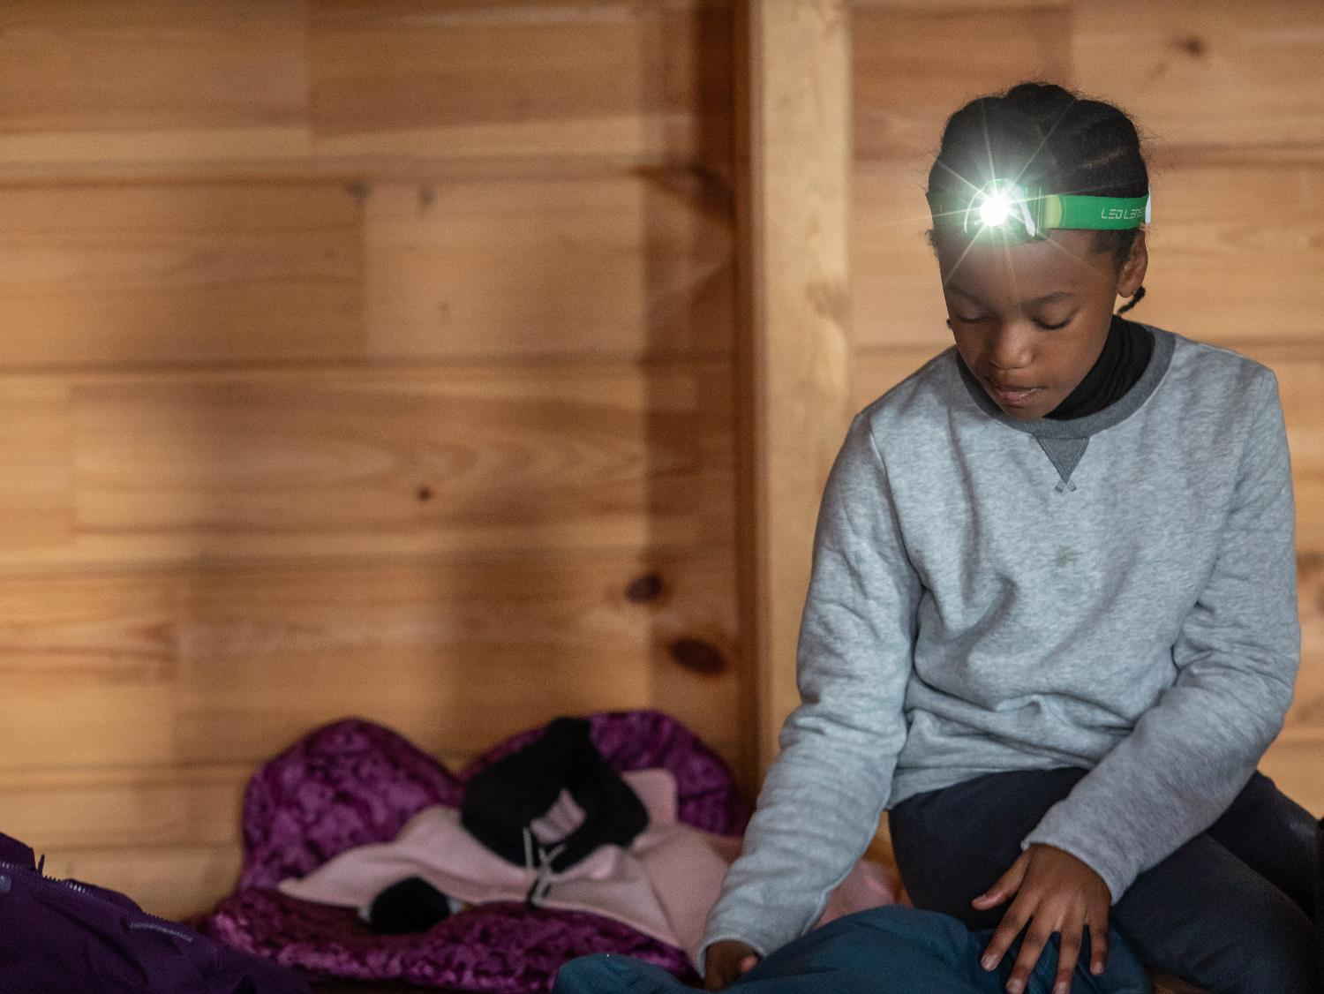
Your programme

Slide 4
Tonight…
Explain plans for next year
Show you typical dorm layout
Talk about a typical day at camp
Show you camp activities
Reasons why cluster camp is positive
Packing lists
Cost and Payment plans

Slide 5
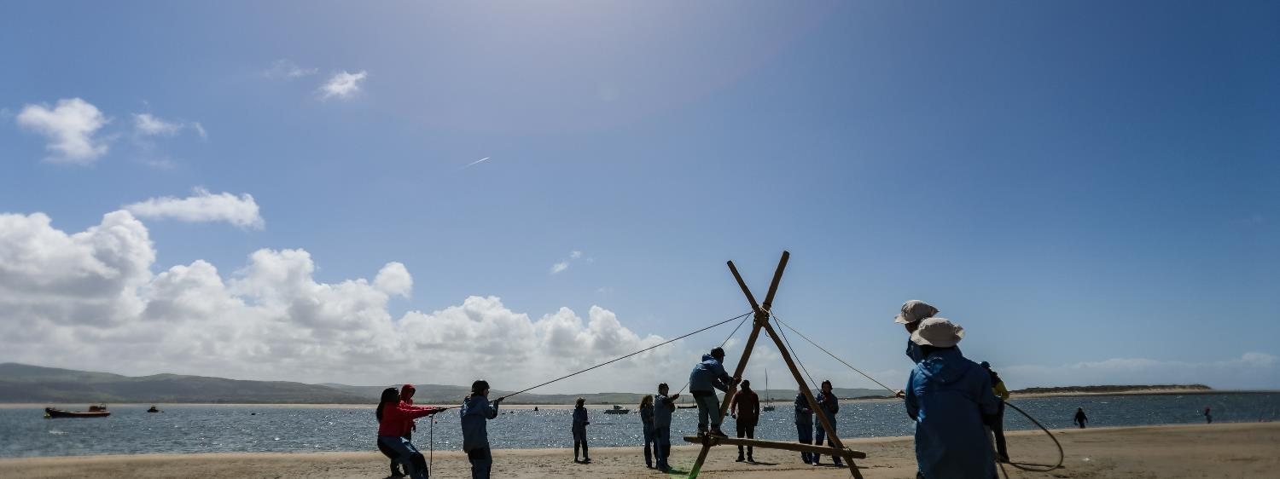
YOUR PROGRAMME
LEARNING OUTCOMES
Increased awareness of own skills and abilities
Improved confidence and self-belief in own abilities
Improved ability to listen and communicate effectively with others
Increased awareness and concern for the natural environment
Increased resilience and determination

Slide 6
YOUR PROGRAMME
THE FINER DETAIL
Dates | 17-21st February
Centre | Ullswater & Howtown (Lake District)
Start time | 1pm | Finish time | 1pm
First meal | Dinner | Last meal | Lunch
Age range of participants | P7 Transition
Number of groups | 14 groups
Number of staff | 1 free staff place per group (14)

Slide 7
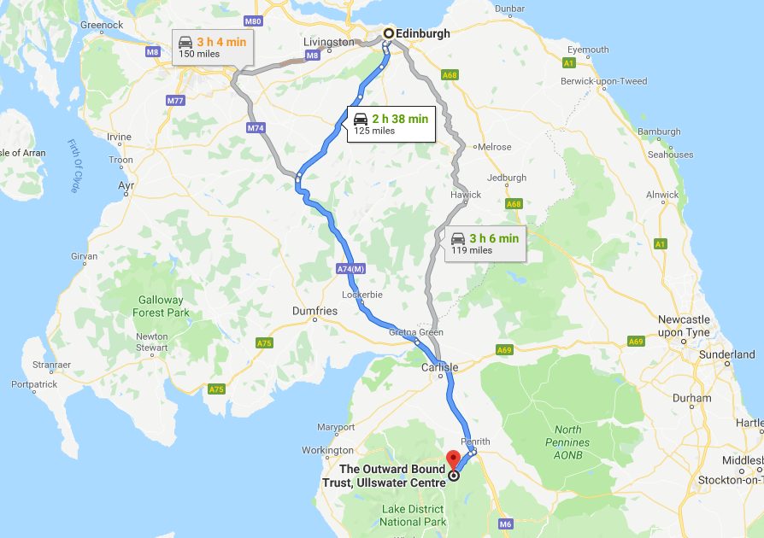

Slide 8
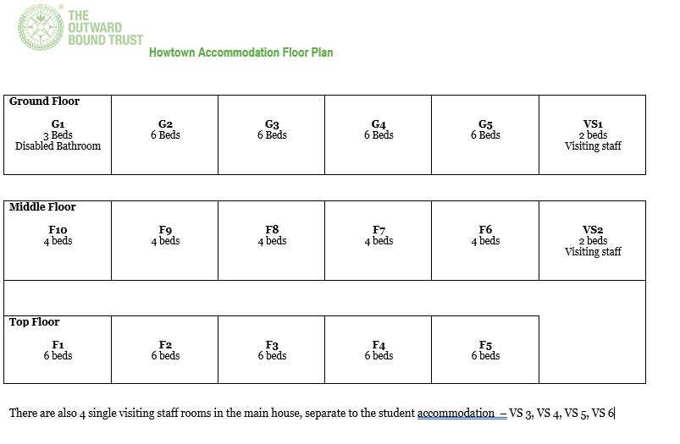

Slide 9
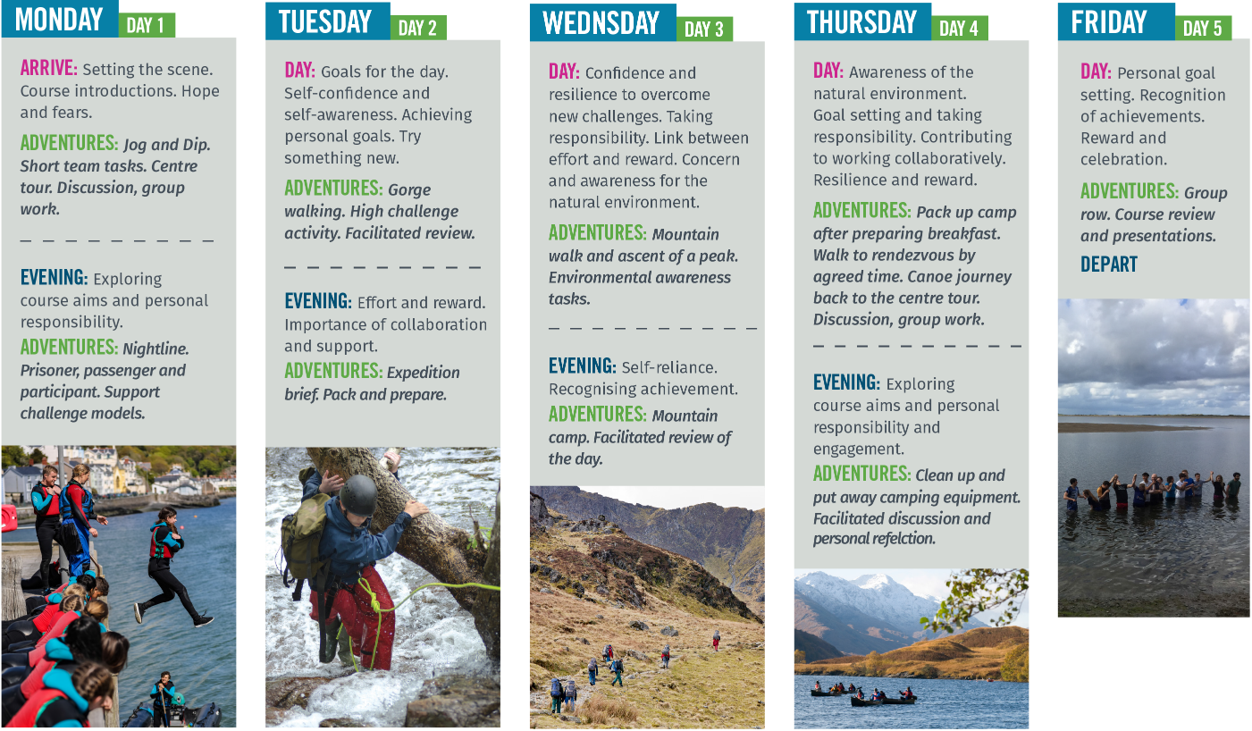
SAMPLE programme
5 DAYS

Slide 10
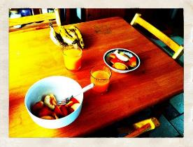
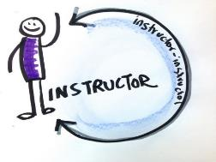
Typical Day…
8.30 – 9.30
9.30- 12.30
12.30 – 1.30 lunch
2 activities

Slide 11
Typical Day…
1.30- 4.30
5.00 – 6.00 Dinner
2 activities

Slide 12
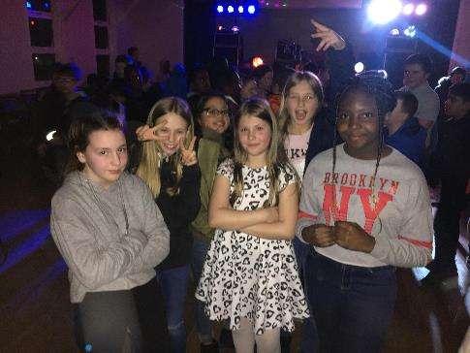
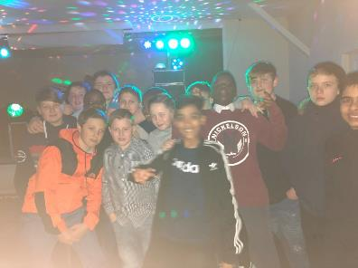

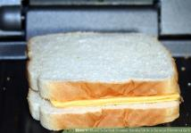
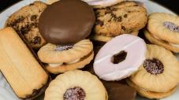
Typical day
6.30 – 8.00
8.00 – 8.30 Supper

Slide 13



Typical day…
8.30 – 9.30
Lights out by 10.00

Slide 14
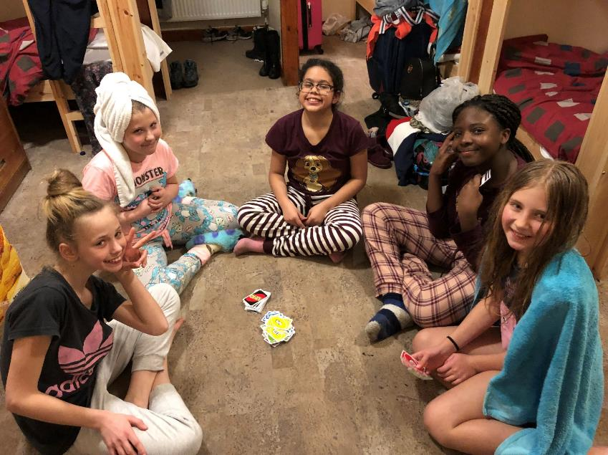
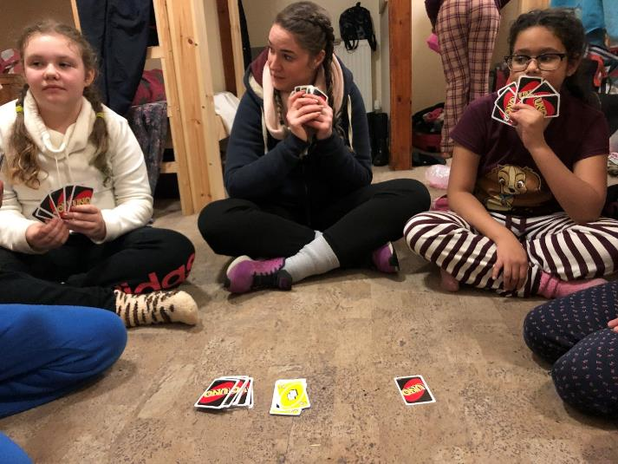

Slide 15
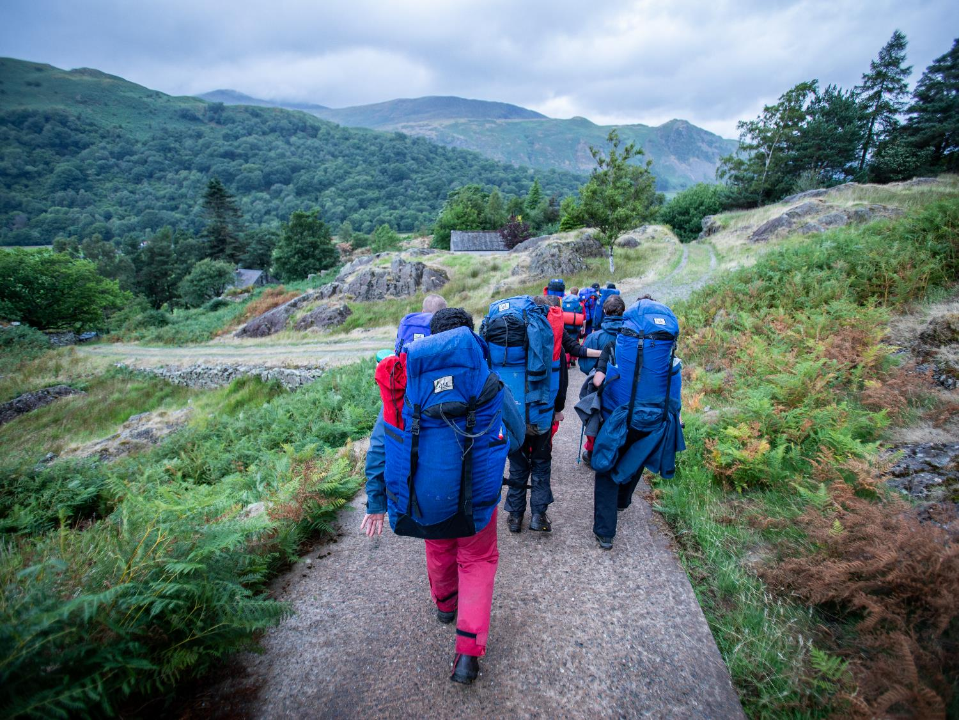
SAMPLE ACTIVITIES
Jog and dip
Mountain expeditions
Gorge scrambling
Raft building
Canoeing
Rock climbing
Orienteering
Kayaking
Understanding nature
Abseiling

Slide 16


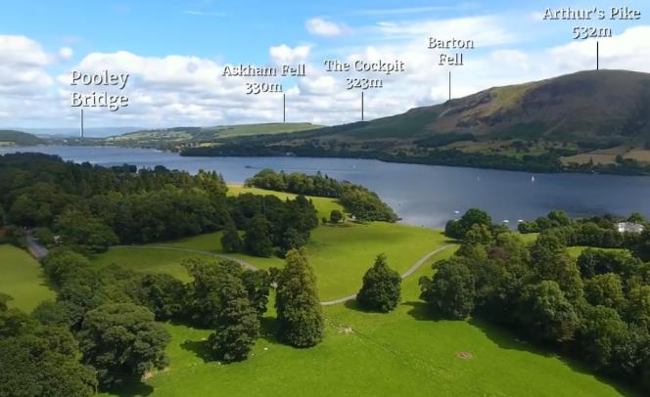

YOUR CHOSEN CENTRE
ULLSWATER, THE LAKE DISTRICT
Outward Bound Ullswater is in the heart of the UK’s
largest national park, with direct access to the lake in its own grounds. It’s a short distance from famous peaks,
like Helvellyn, and its recent refurbishment won it a ‘Best Educational Building’ award. As part of the upgrade, ten learning pods are set in the woods to give a sheltered
and inspiring ‘outdoor’ location to review the days learning.
Notes:
Ullswater
Started as Outward Bound’s Mountain school in 1955 The main building is a Grade 2 listed Georgian mansion and it’s set in 18 acres of woodland.
Situated on the shores of Ullswater in the Lake District
Employs 75 staff and Aramark provide the hospitality services
Has beds for 120 customers
Underwent significant (£3Million) redevelopment in 2017 and won the “Best Educational Building Award” following this.

Slide 17
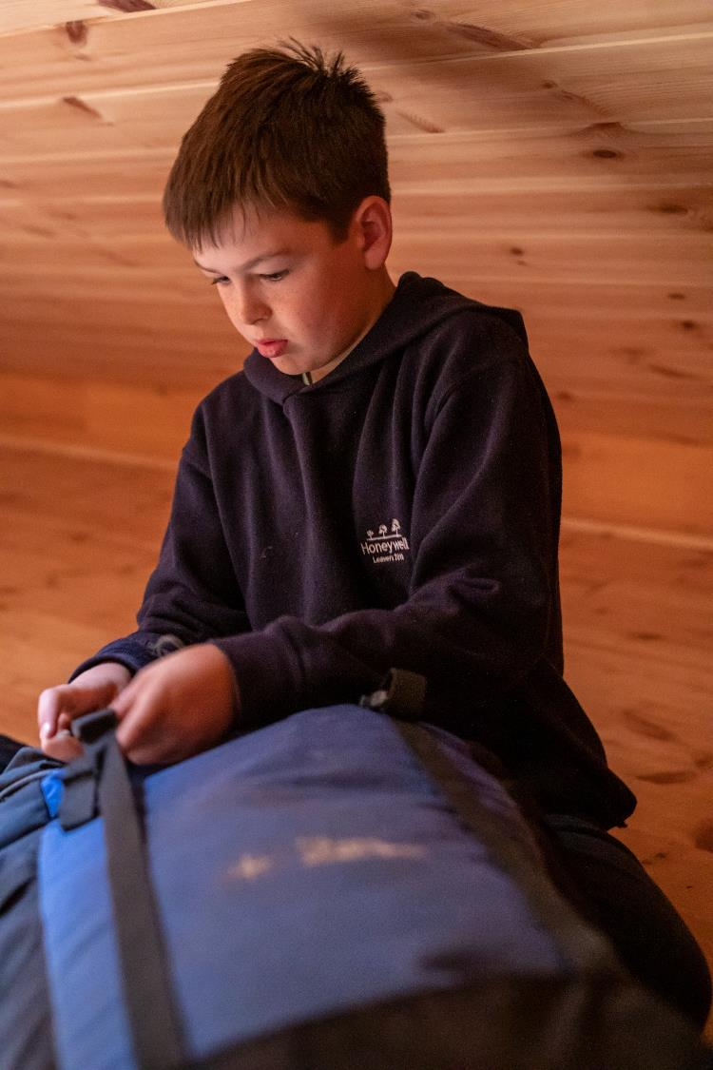
THE BEST LEARNING
HAPPENS OUT IN THE WILD
Your students. Our instructors. One wild location. Let’s do this.
Limitations on young people, whether real or perceived, come in all shapes and sizes. But we use the power of learning and adventures in the wild to defeat them all.
We partner with schools and colleges to teach young people the most important lesson they could ever learn: to believe in themselves.
It’s the superpower that transforms their behaviour throughout school, work and beyond.

Slide 18
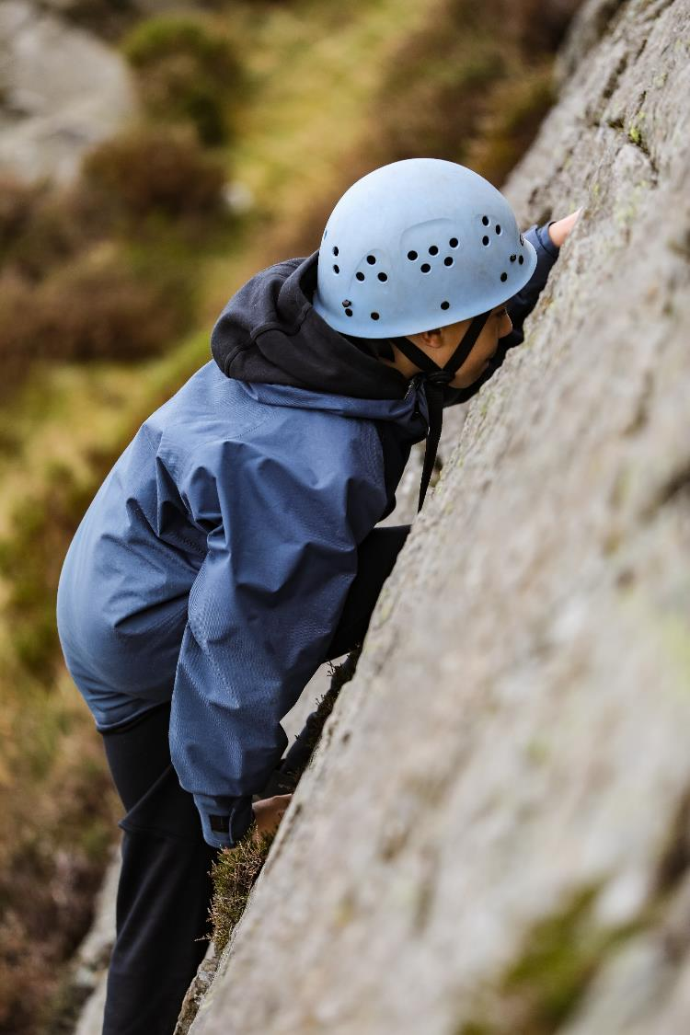
Not your
BOG-STANDARD RESIDENTIAL
No two courses are the same. Your programme is made to order depending on your learning needs.
One dedicated instructor for each group for the entire course.
Hugely impactful experiences like no other, including carefully planned wild overnight expeditions.
Backed by an independently-reviewed evaluation programme so our courses make a real difference.
All-inclusive, so all food, accommodation, tuition, 24-hour pastoral care and comprehensive insurance are included.

Slide 19
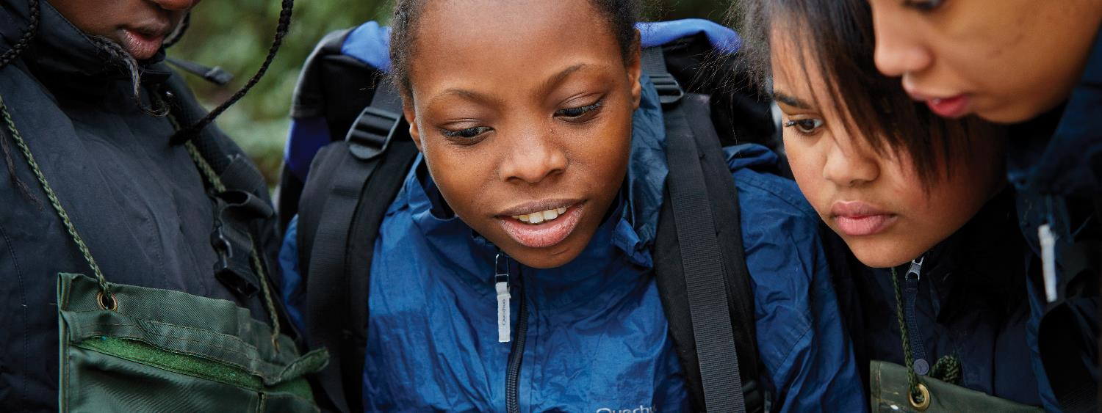
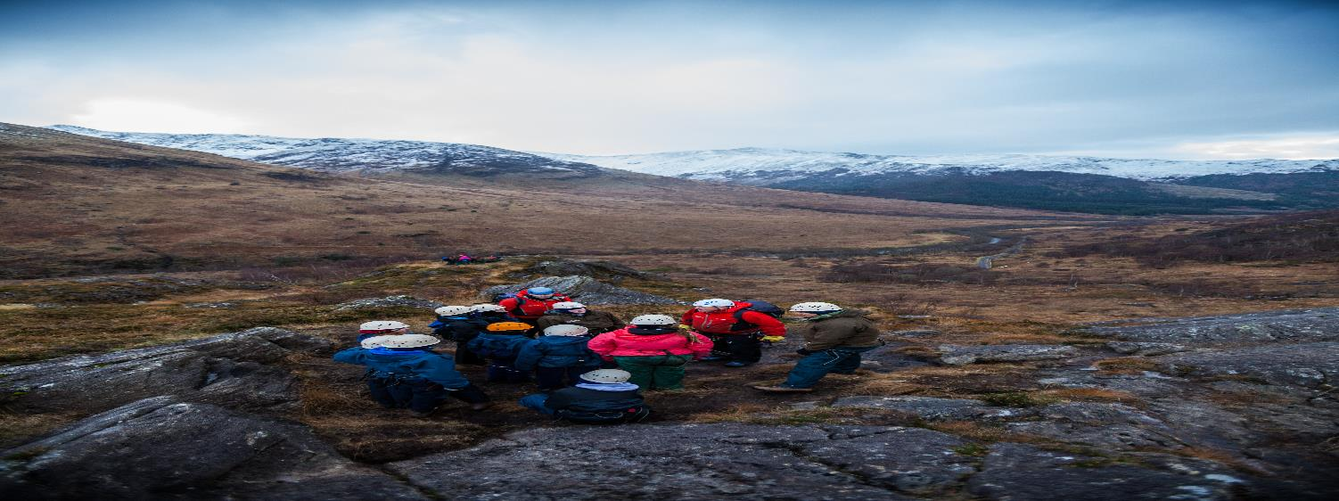
Our
PILLARS OF
Change
1. Self-Belief & Resilience
2. Improving chances
3. Hunger for Challenge
4. Great relationships
We inspire young people to believe they are capable of more, and to get up when they are knocked back.
We develop skills in young people, which help lead to better life chances, particularly those from less privileged backgrounds
We inspire young people to seek out challenge, not be afraid of it, and be risk aware, not risk averse.
We promote the importance of strong, authentic relationships to develop internal self worth and a sense of belonging in the world.

Slide 20
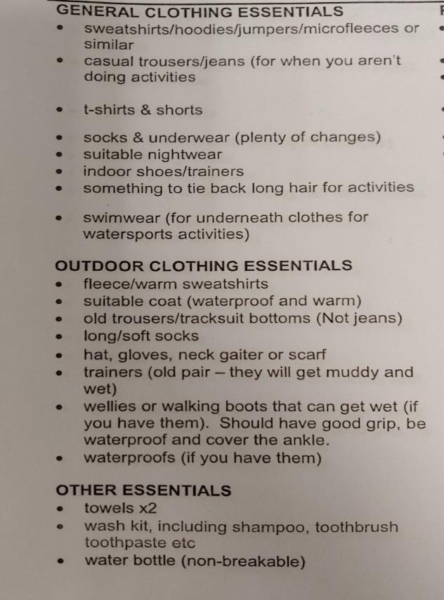
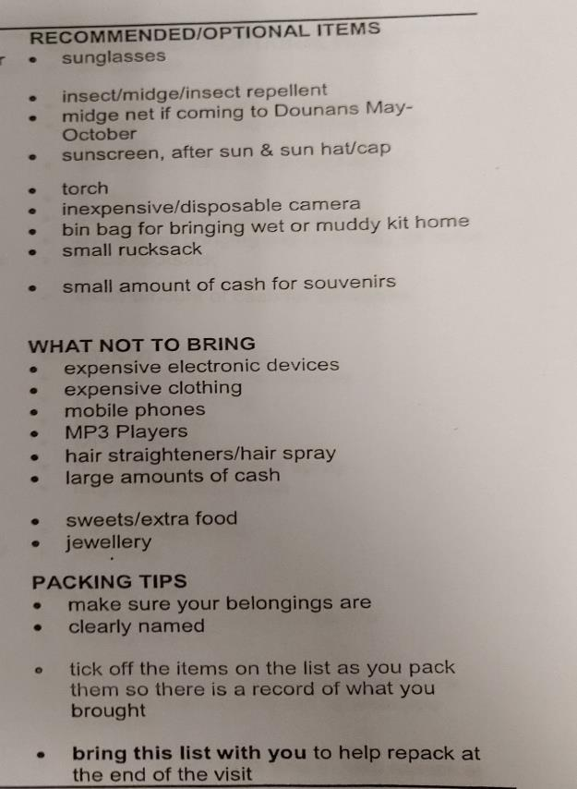
Kit List – Be Prepared!
Notes:
Grace

Slide 21
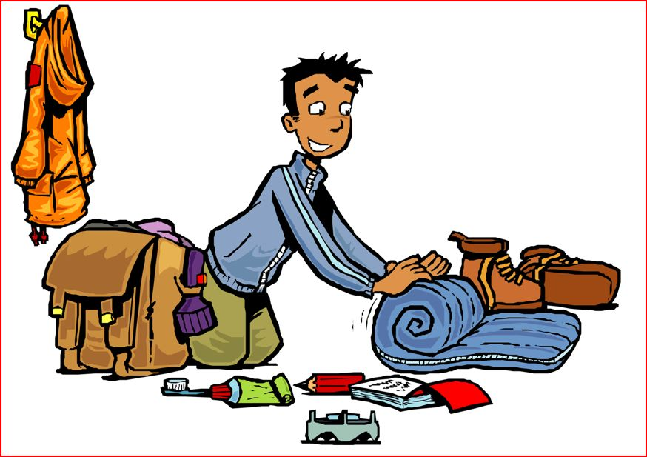
Old Old Old

Slide 22



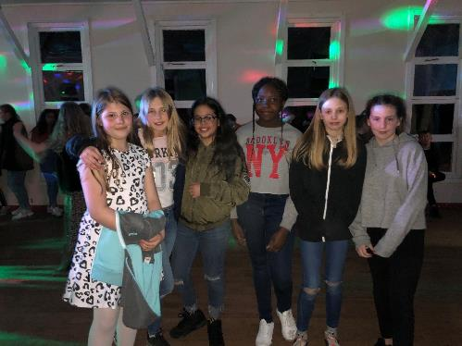
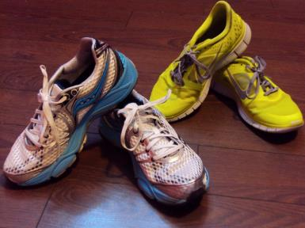


Slide 23
Payments
Deposit of £30 no later than 1st June . Deposit is non refundable.
The cost of camp per child will be £300 approximately.
This amount is subject to parental engagement in fund raising.
This can be paid through Parent Pay.

Slide 24
Paying every second week:
Payment 1 (Deposit) £30 – 31.05.19
Payment 2 £22.50 – 14.06.19
Payment 3 £22.50 – 28.06.19
Payment 4 £22.50 – 05.07.19
Payment 5 £22.50 – 19.07.19
Payment 6 £22.50 – 02.08.19
Payment 7 £22.50 – 16.08.19
Payment 8 £22.50 – 30.08.19
Payment 8 £22.50 – 13.09.19
Payment 9 £22.50 – 27.09.19
Payment 10 £22.50 – 11.10.19
Payment 11 £22.50 - 25.10.19
Payment 12 £22.50 – 08.11.19
Payment 13 £22.50 - 22.11.19
Paid before Christmas

Slide 25
5 Instalments
Payment 1 (Deposit) £30 – 31.05.19
Payment 2 £54 – 31.07.19
Payment 3 £54 – 30.09.19
Payment 4 £54 – 31.11.19
Payment 5 £54 – 31.02.19

Slide 26
Monthly
June 2019 | £30
July 2019 | £33
August 2019 | £33
September 2019 | £33
October 2019 | £33
November 2019 | £33
December 2019 | £33
January 2020 | £33
February 2020 | £39

Slide 27
Paid by 1st February
-any fundraising money that reduces the cost will be given back to each family before leaving.

Slide 28
Any questions…

