Slide 1
Numeracy
Week 2 – 18th January 2021

Slide 2
Numeracy: Our Schedule for This Week
Numeracy:
This week we are going to continue what we have started at the end of the term:
Task 1- Mental Maths ( try and time yourselves or ask an adult to help you )
Task 2 – Video 2 with Worksheet 2 ( Long Multiplication )
Task 3 – Video 3 with worksheet 3 (What is a fraction?)
Task 4 – Mental Maths ( either do this on the Friday morning or do a box each day)
Maths:
Activity 1
Famous Mathematicians – The Worksheet is in a pdf file ( not on the slides )
This activity will take you longer than one week so take your time doing this activity.
This activity involves research.
There is a worksheet that gives you all the details.
Activity 2 – Time ( Choose your own way of presenting this time table )
Let us make our lockdown time table.
Please create your time table during this lockdown and share it with me.
Give me times in both 12 hour format and 24 hour format
Calculate the time you spend doing your activities
Remember – I am available from 1pm – 2pm for questions and for extra support

Slide 3
Task 1: Long Multiplication
There are 3 boxes choose one box ( Please try and challenge yourself)
Watch the video on this link:
https://www.youtube.com/watch?v=dNSrfoYLQZU
245 X 24 =
345 X 52 =
124 X 32=
213 X 14 =
169 X 22=
222 X 16 = .
345 X 12 =
412 X 14=
242 X 2 =
345 X 5 =
124 X 3=
213 X 4 =
169 X 2=
222 X 2 = .
345 X 3 =
412 X 4=
24 X 12 =
34 X 11 =
12 X 22=
21 X 13 =
13 X 13=
22 X 42 = .
45 X 13 =
41 X 11 =

Slide 4
Task 2:Fractions – What is a fraction
Watch the video below and answer the following problems in the next few slides
https://vimeo.com/498327271

Slide 5
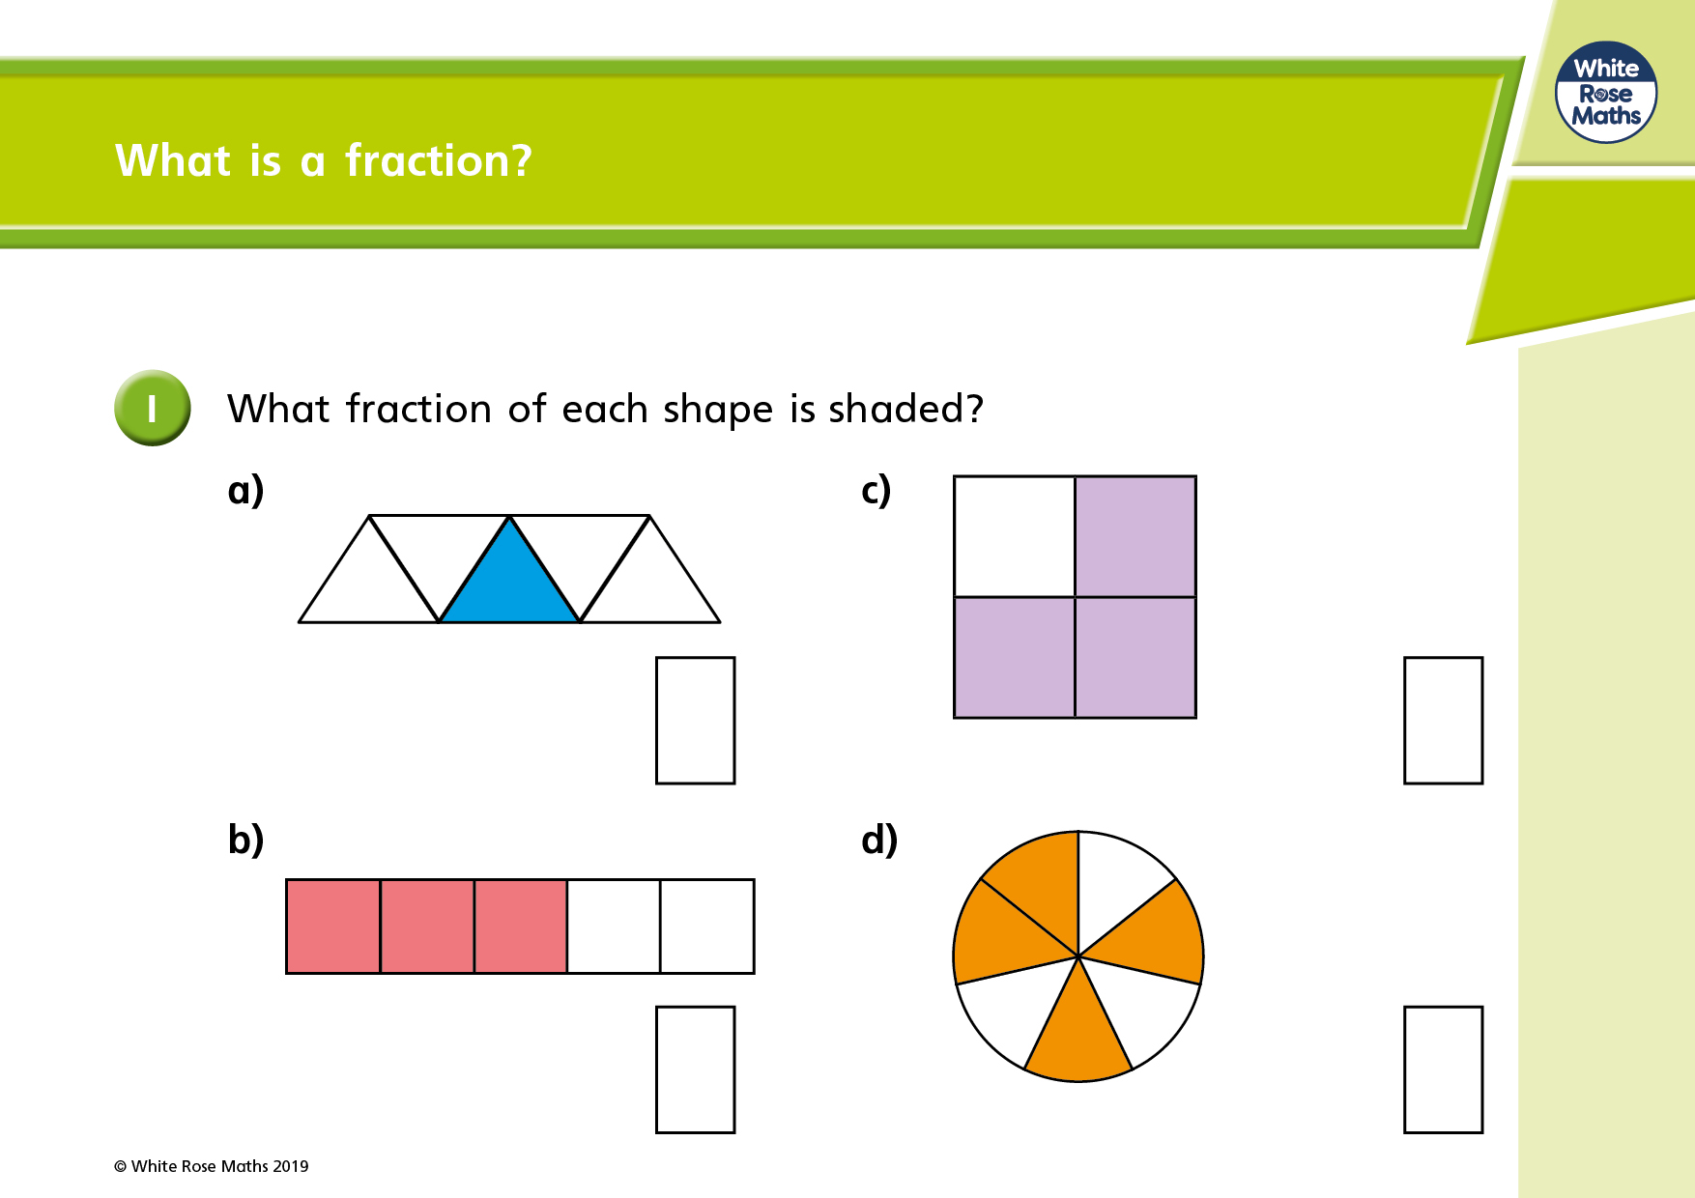

Slide 6
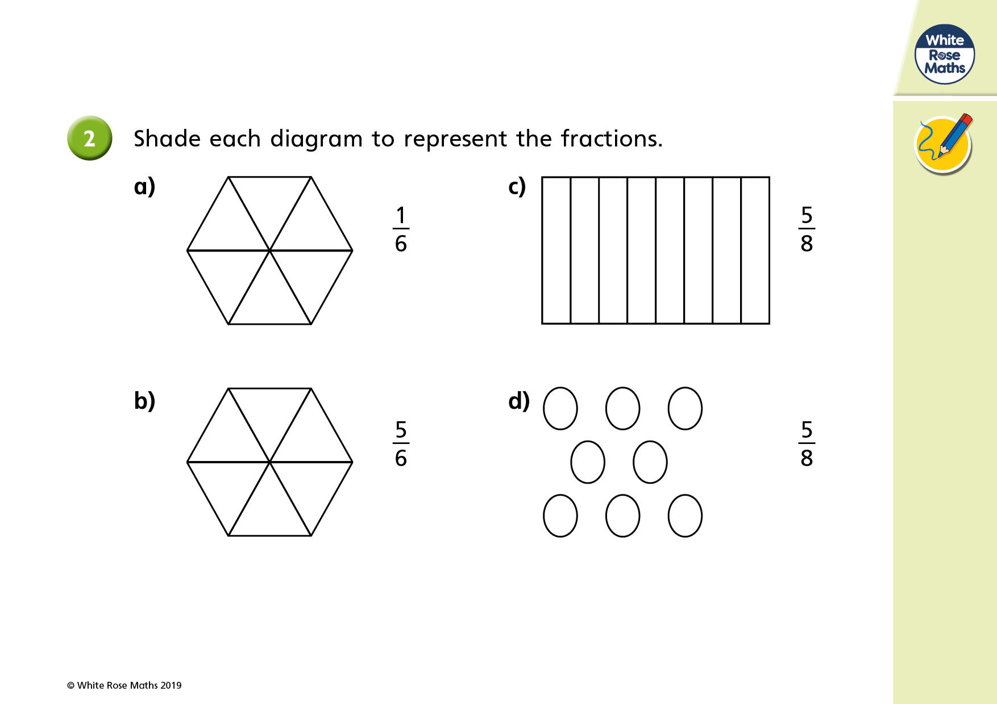

Slide 7
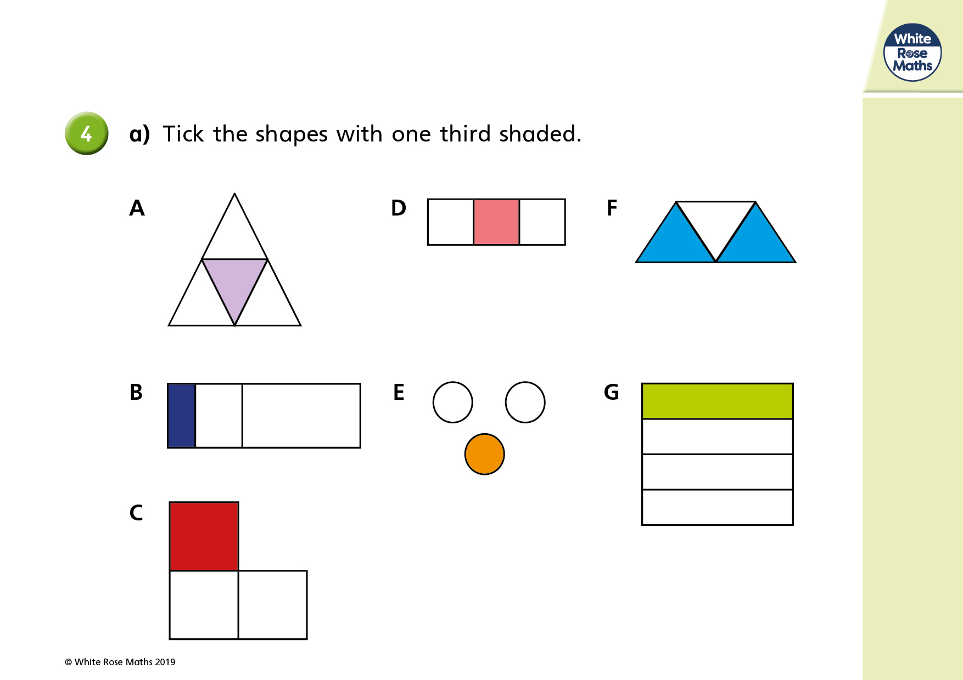

Slide 8
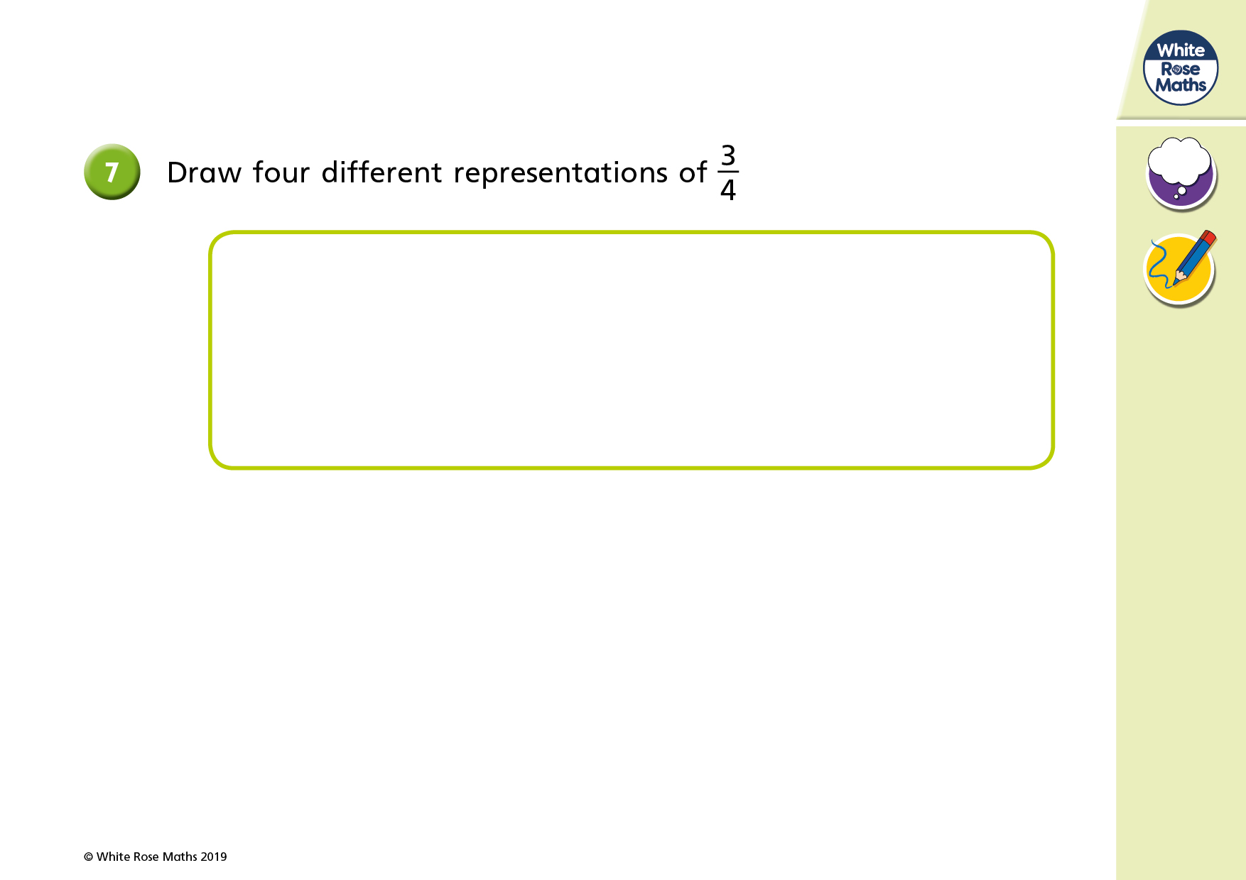

Slide 9
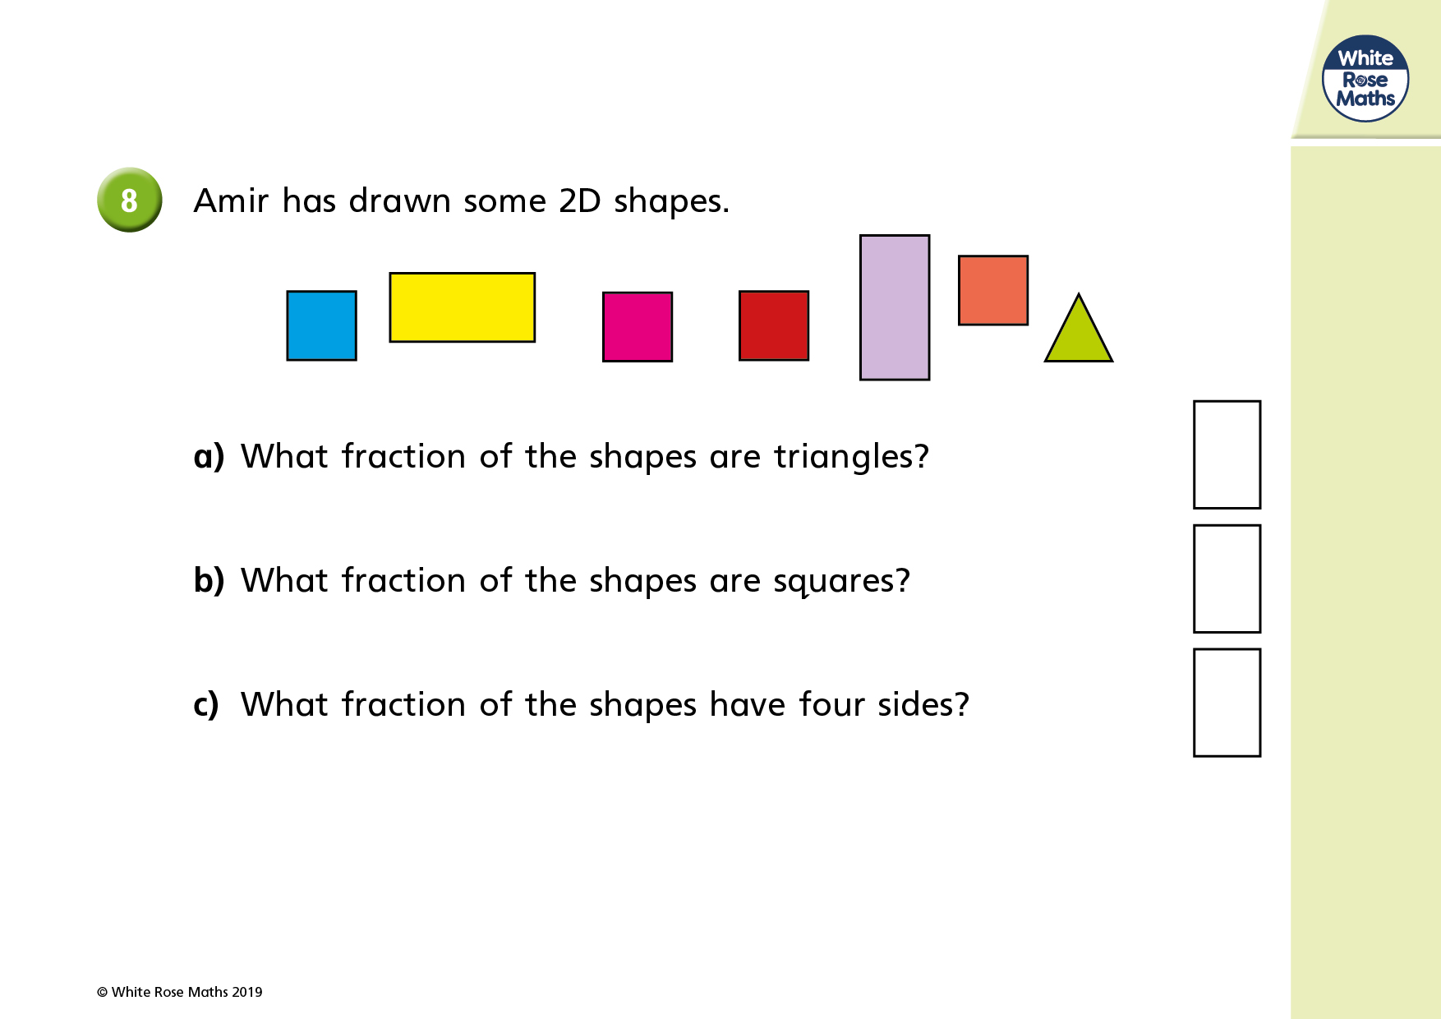

Slide 10
Task 4: Daily Mental Maths Challenges P6 - Week Beginning 18th January 2021
To Complete mental maths tasks you need to ask an adult or friend to read the questions out loud to you. You then have say, 20 seconds, to write down your answer before moving on to the next question. Good luck.
54÷ 9 =
81÷ 9=
What is the sum of forty and thirteen?
How many eggs are there in a dozen?
9+20+40=
Round 875 to the nearest 100.
50 X 5 =
4 X 12 =
4+ __= 15
9+___= 22
8-___= 2
17- __ =15
9+__= 28
(6) 4+__+5= 10
(7) 8+__= 16
(8)7 +__= 16
Midnight in 24 hours is 00:00 T/F
Add 5 mins to 20:42=
1 hour has ____ minutes
Choose write answer: 17:00 hours is :
a – 5 pm b- 5 am c 5:30 pm
(5) I started walking at 8 pm and finished at 9.30 pm ? How many minutes did I walk for?
(6) Take away 15 mins from 60 mins ?
(7) I went to my friend’ s house at 8 am and stayed there for 2 hours. What time did I get back home?
(8) How many days are there in 1 year ?

