Slide 1
Welcome to week 6 of home learning P5!
Complete:
one literacy
one numeracy
one other task each day.
Remember our class motto:
Stay on task!

Slide 2


P5 Home Learning. Week beginning Monday 22-02-2021
Numeracy & Maths
Complete maths and numeracy activities every day.
Log in and complete the challenges I have set in Sumdog.
Task 1: Complete the safe challenges saved in teams.
Good Luck.
Task 2: Division with remainders
Remember the bus stop method?
Join me on Monday to revise the method and complete the worksheet called bus stop division.
Complete these questions.
13/2= 22/7=
46/9= 28/5=
4/3= 47/12=
55/6 42/9=
83/11= 18/4=
Task 3: Read and just write the answer.
There are 40 pencils in 4 boxes. How many pencils in 1 box?
Each bunch of bananas has 4 bananas how many bunches would 28 bananas make?
Make 5 questions of your own, like the ones in Task 3.
Nominate a friend on Teams to answer them. Give them a thumbs up if they get the answers right!
Challenge:
You have 5 minutes to make the number 56 using + - x ÷.
Mental Maths:
Add 21 + 45=.
What is 60+90?
How many angles does a square have?
Round 436 to the nearest hundred?
What is 100-45=?
What time is it right now?
What 11 x 12?
2ms is how many cms?
What year is 3 years after 2034?
I have a 1l water bottle, I drink 200mls of water and another 500mls of water, how much liquid will I have left?
Task 4
Continue to practice your times table practice here

Slide 3
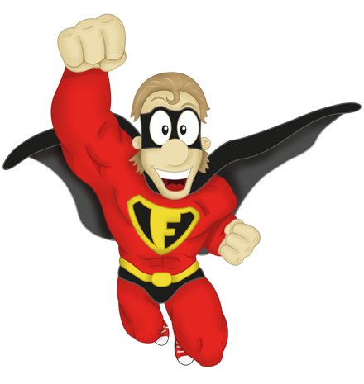
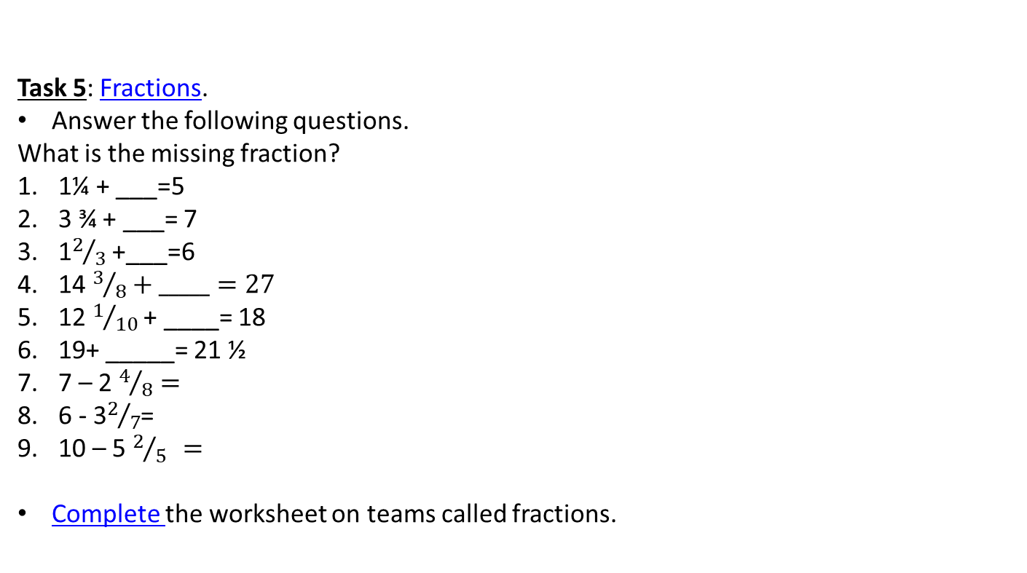
Task 5: Fractions.
Answer the following questions.
What is the missing fraction?
1¼ + ___=5
3 ¾ + ___= 7
1$2/3$ +___=6
14 $3/8+_____=27$
12 $1/{10}$ + ____= 18
19+ _____= 21 ½
7 – 2 $4/8=$
6 - 3$2/7$=
10 – 5 $2/{5 }=$
Complete the worksheet on teams called fractions.
2
1
1
3
=
5
+
3
3
0
1
2
3
4
5

Slide 4


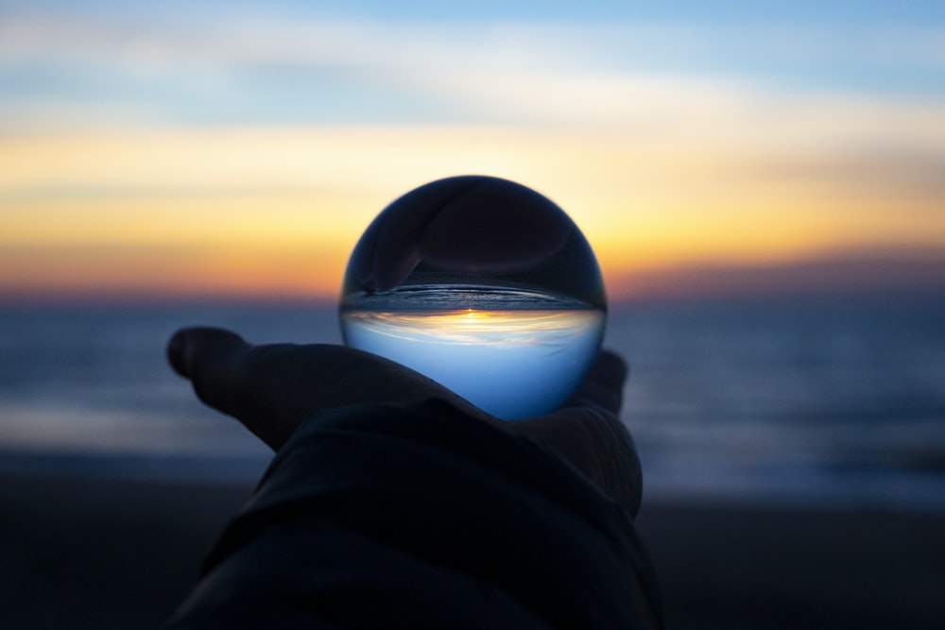
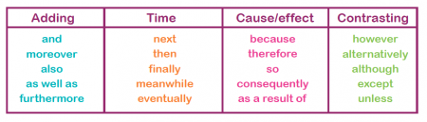
Literacy and English
Do some English and literacy activities every day.
Parents, if you haven’t already done it, please register for a free account on www.oxfordowl.co.uk
Reading
This week we will catch up with our class novel.
We will read what happens next in chapter 4 this week. Monday 11am.
Complete the Charlotte Web thinker reader.
Spelling and handwriting
Your spelling words are on Sumdog this week. Please make sure you log on to complete your spelling.
Task 1:
We will have a spelling test on Thursday at 11am.
Task 2:
Write a sentence with your spelling word- neatly and with cursive handwriting.
Grammar:
Use a connective to lengthen your sentence, Try to using the examples we have used in class
.
Listening and Talking: What questions would you ask?
Watch and listen to the conversation in this clip. Ask an adult to watch it with you and talk about what you like about it and what questions you would ask.
Then think about what the world will be like if you live to be 101! What would you have seen, what might be different about how we live, the cars we drive, the school we learn in….
Share your thoughts on teams.

Slide 5
Writing
Task 1: Grammar- past/present/future
Look at the verb underlined in each sentence and tell me if it is in the past/present/future
The baby dropped her teddy.-
The weather forecaster said the sun will shine in Edinburgh tomorrow. -
Mrs. Sharkey always says “Stay on Task” to P5. -
P5 bought a play station for free play! –
Copy out these example into the right column- Past/present/future:
Will try- was hoping- laughs- will win- begged- listening- broke-yawns-was-annoyed.
Grammar detective!
Listen to the news and list the different examples of past/present/future verbs. Share on teams what you heard.
Task 2: Report Writing:​
​Please finish your report from last week.
This week practice writing reports.
This week write about the corona virus and what changes are in place and what rules we need to follow:
School/Sport/Shopping/Play/Meeting friends/ .
Use the report template to help plan you writing.
Include:
Facts and data about the virus
Rules that are in place here in Edinburgh.
Use responsible news website only.
Past | Present | Future

Slide 6

RE
First Sunday of Lent Gospel: Mark 1:12-15
Pray:
Dear Lord
Let us remember the people who live in areas where water is hard to find, unclean and not enough of it. We pray for our parish, family and friends: that we may make changes to our lives this Lent that will change the lives of others around the world. Lord, in your mercy...
complete the illustration for the first week of lent.
Lent
Adults will fast and abstain ( avoid ) from eating meat, pray and give to charities/help other people.
What will you do this lent? Talk to your family and share your ideas on teams. We will display your artwork in school on a special display board for the P1-3 to see.
If you do not practice Lent, what do you do to prepare for special days?
Health and Wellbeing
Building Resilience
We are all grateful to doctors and nurses who are working so hard to keep everyone around the world safe and well.
As we stay patient waiting for when we will return to school, draw your own rainbow and inside each stripe write a thing in your own life that you are thankful for. It can be a simple thing or a great big thing. It is up to you.
Even when things seem hard it is good to see the rainbow of good things around you.
P.E. ​
Continue to work through the tasks Mr Creaney’s PE Grid.
Share on teams a Sport routine that we need to do every day next week- the class will vote on which one we do on Thursdays HWB catch up!

Slide 7

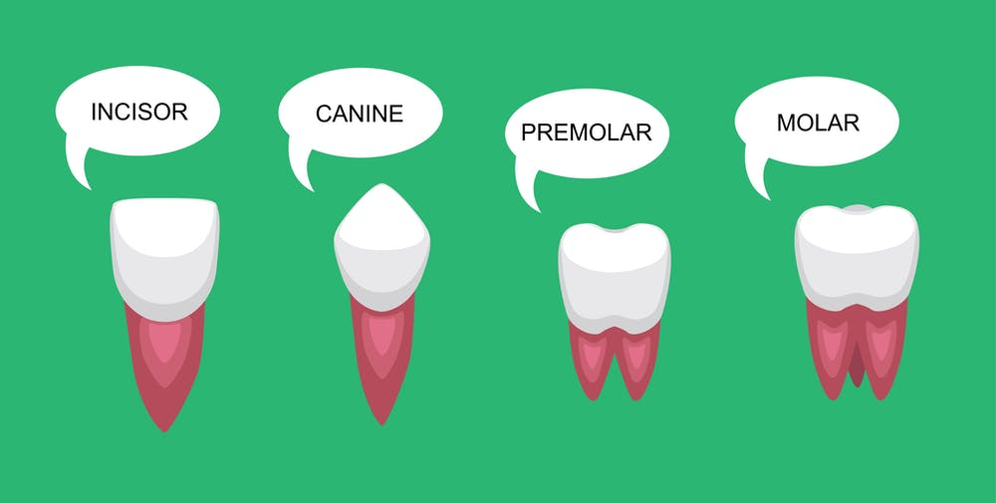

Social Studies
Have you noticed that people are more active during lockdown? I have seen families walking together.
Can you think about one good change that you have noticed during lockdown?
Make a poster to say why we should keep this change even after we go back to school and work. Use words and pictures to make your message clear.
Post your work on Teams.
Science
How do our bodies work?
Why do we lose our baby teeth?
​
Art
It is soo exciting. Immaginate begins on Tuesday.
At 11am Greg will be send us a link to watch and has 3 tasks for you to complete.
You will need:
your Ipad,
paper to draw on and
pencils to use.
Ears to listen!
Remember resources are available from the school if you need them.
Post a picture on Teams.
Spanish- La fiestas
Watch this clip of a famous festival in Spain.
This clip combines colours and the verb to like.
listen and translate what the boy and girl say at the end of the clip.
Share your ideas on teams.
Pesa mucho- costs a lot.

