Slide 1
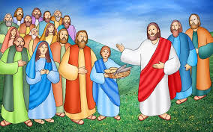
Primary 4
February week 5
Life of Jesus
‘Jesus feeds the Five Thousand’
Pupil Resources
Notes:
The activities in this power point can be done over the course of one or two week and will also give other opportunities for IDL.

Slide 2



What are we learning about this week?
I am learning :
*about The Feeding of the 5000( Matthew 14:13-21)
*that Jesus teaches, heals and nourishes us when we ask him
*that Jesus performed miracles whilst on earth
. I can :
*reflect on The Feeding of the 5000
*ask God, in prayer, for what we need
*discuss my thoughts about the miracle of the Feeding of the 5000
2

Slide 3
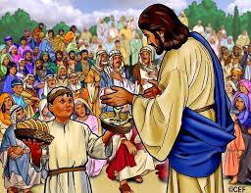
Our Class Altar
Jesus feeds the Five Thousand
Jesus had been preaching all day to a huge crowd of people (at least 5000 men and also women and children)
It was late and there was nowhere for the crowds to get food
Jesus told the apostles to feed the people but they only had five loaves and two fish
Jesus said some prayers of thanksgiving and amazingly, when the apostles started to give out the food, there was more than enough to feed everyone
The people were amazed as they knew they had witnessed a miracle
If you have a bible, read this in Matt 14:13-21
Notes:
Use the prompts on this slide to tell the children that we are going to read a piece of scripture which tells about one of the miracles Jesus performed during his earthly ministry. It is important to stress that the apostles didn’t understand what Jesus was asking them to do but they trusted him. Explain to the children that we don’t need to understand everything God asks us to do but we need to have faith that he has a greater plan. If a bible is available, this can be shared with the children. It is also available on the next slide, slide 4.

Slide 4
Matthew 14 :13-21
When Jesus heard what had happened, he withdrew by boat privately to a solitary place. Hearing of this, the crowds followed him on foot from the towns. When Jesus landed and saw a large crowd, he had compassion on them and healed their sick.
As evening approached, the disciples came to him and said, “This is a remote place, and it’s already getting late. Send the crowds away, so they can go to the villages and buy themselves some food.”
Jesus replied, “They do not need to go away. You give them something to eat.”
“We have here only five loaves of bread and two fish,” they answered.
“Bring them here to me,” he said. And he directed the people to sit down on the grass. Taking the five loaves and the two fish and looking up to heaven, he gave thanks and broke the loaves. Then he gave them to the disciples, and the disciples gave them to the people. They all ate and were satisfied, and the disciples picked up twelve basketfuls of broken pieces that were left over. The number of those who ate was about five thousand men, besides women and children.
Notes:
Read this piece of scripture then what the video clip on slide 5.

Slide 5
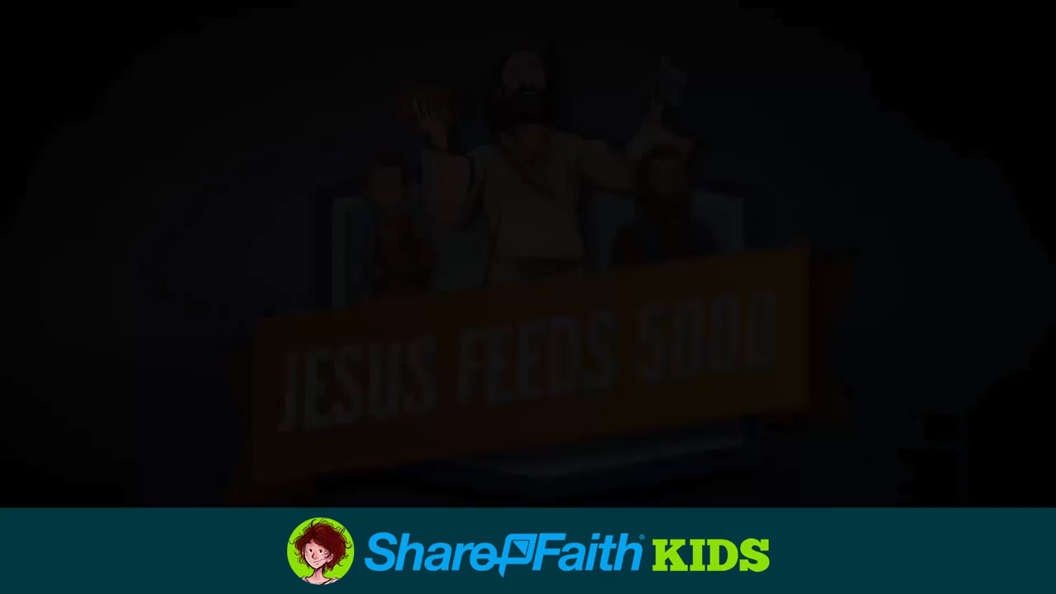
Jesus feeds the five thousand
Notes:
This short clip illustrates Matthew 14:13-21.

Slide 6

Let’s think about the scripture
Why do you think the people didn’t bring food with them?
Why do you think Jesus told the apostles to feed the people?
Why did the apostles do as Jesus asked even though it made no sense to them?
Jesus said a prayer of thanksgiving before the food was shared-have you seen something similar done at Mass?

Slide 7

The Feeding of the 5000 song
Notes:
This is the music which will be used during the short prayer service. Children can listen and join in where they can.

Slide 8
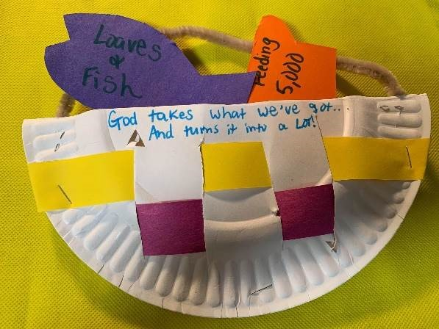
Five loaves and two fishes craft
Cut a paper plate/paper circle in half
Staple/tape the two halves to form the bottom of your basket
Make and attach a handle from a strip of paper or some pipe cleaners
Decorate your basket and write ‘God takes what we have and turns it into a lot’
From paper, cut out shapes of 5 loaves and two fish
Remember- God can take a little and do wonderful things!

Slide 9

Time for prayer
Sign of the cross
We light the candle to remind us God is with us when we pray
Father in Heaven, when Jesus was on earth, he performed many miracles.
Help us learn about the miracles he performed.
Teacher: Lord hear us Children :Lord graciously hear us
Father in heaven, the centurion was not afraid to ask for Jesus’ help,
Help us to pray when we need your help.
Teacher: Lord hear us Children :Lord graciously hear us
Father in heaven, the centurion prayed for someone he cared about.
Help us to remember to pray for our loved ones.
Teacher: Lord hear us Children :Lord graciously hear us
Father in heaven, the centurion thanked Jesus for healing his servant..
Help me to remember to give thanks for your many blessings.
Teacher: Lord hear us Children :Lord graciously hear us
Let us finish today’s time of prayer by saying together….Lord I am not worthy that you should enter under my roof but only say the word and my soul shall be healed
We play our song to end our time of prayer
Notes:
Gather the children round for this short prayer service. Light a candle (or battery one) if you have one. Click for each line and response. To play the song, click on the l arrow

Slide 10
What have we learned about this week?
I have learned :
*about The Feeding of the 5000 (Matthew 14:13-21)
*that Jesus teaches heals and nourishes us when we ask him.
*thatJesus performed miracles whilst on earth
. I can :
*reflect on The Feeding of the 5000
*ask God, in prayer, for what we need
*discuss my thoughts about the miracle of The Feeding of the 5000.
10

