Slide 1
Home Grid
Week 3rd May 2021

Slide 2
A Quick Note From Ms. Vella
Welcome Back Witamy Bienvenidas
Hello in this presentation there is work for the next two days while we self- isolate
See you all on Friday
Dzien dobry ta prezentacja bedzie dostepna przez kelejne dwa dni do konca izolacji.
Do zobaczenia w piatek
Hola esta presentacion tiene trabajo para los proximos dos dias mientras nos vemos el viernes

Slide 3

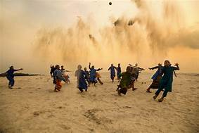

Estimation
What is the definition?
Can you list 3 synonyms and 2 antonyms?
Can you write a sentence using this word accurately?
Name the country
Name the Capital City
Find out 3 random facts about the country
19 | 135
Add 25 | Add 35
Double it | Add 586
Subtract 10 | Subtract 25
Welcome to our Daily Challenges
Try one a day if you have time try more
Write a few sentences about this picture
TUMMENNRAETTUG
Try and write as many words as possible

Slide 4
Numeracy
Starter Tasks for Wednesday and Thursday
Worksheets for Perimeter and length

Slide 5
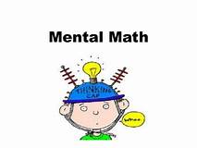
Task 1: Starter Task
Wednesday:
List all the factors of 18:
How many times is 58kg than 4kg?
There are thirty- two children in the classroom. Four students can sit use one table. How many tables are needed
Divide twenty by the total of 2 plus 2?
Thursday:
Share £80 between 8 people?
What is the total of 175 plus 12 plus 35?
Find the missing number _ + 49= 105
How many hours are there in 360 minutes?

Slide 6
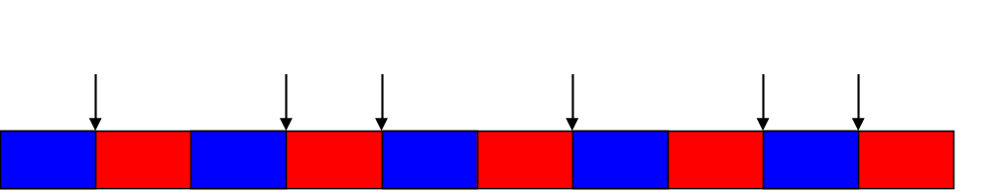
Length – Dlugosc - Larga
A B C D E F
There are 100 centimetres in one metre. Using the metre stick above, fill in what each
letter represents in centimetres.
The first one has been done for you.
A= 10cm B=___ C= _____ D=______ E=_____ F=_____

Slide 7
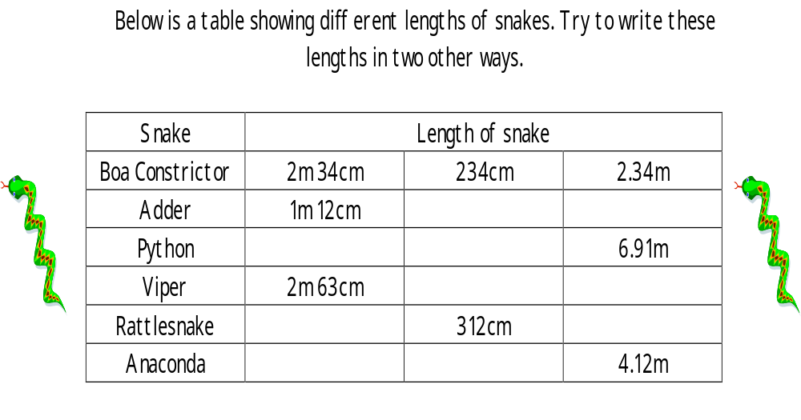

Slide 8


Perimeter : Find the missing measurement
Remember use the correct measurement for your answer
This square has a perimeter of 44cm.
How long is each side?
Show how you worked this out:
__________________________________________________________
2. This triangle has a perimeter of 81m.
How long is the missing measurement?
Show your working
____________________________________
?
21m
30m

Slide 9


3. What is the perimeter of a hexagon where
each side is 27cm long?
Hexagon (6 sides)
Show how you worked this out:
__________________________________________________
4. A farmer has an odd shaped field that he wants to put a fence around.
How much fencing should he buy?
Show how you worked this out:
_________________________________________
11m
10m
10m
9m
8m

Slide 10

RE:
May: Marian month: The month dedicated to Our Lady:
In May of 2002 Pope John Paul II said, "Today we begin the month dedicated to Our Lady a favourite of popular devotion. In accord with a long-standing tradition of devotion, parishes and families continue to make the month of May a 'Marian' month, celebrating it with many devout liturgical, catechetical and pastoral initiatives!“
During these two days show your devotion by saying this prayer.

Slide 11
Literacy:
Starter Tasks : Read a book for 30 mins a day. If you do not have a book, last Friday I have given you some legends for reading.
Writing Task 1: Film Review /Game review
Look at your success criteria and edit your work
Writing Task 2:
Look at your success criteria and edit your work

Slide 12

Title of the film:
_________________________
Star Rating
Summary of the Plot :
_____________________________________________________________________________________________________________________________________________________________________________________________________________________________________________________________________________________________________________________________________________
List the main characters: Which character did you like most and why?
___________________________________________________________________________________________________________________________________________________________________________________________________________________________________________________________________________________
Who would enjoy this film and why?
____________________________________________________________________________________________________________________________________________________________________________________________________________________________________________________________________
Picture of the film:

Slide 13


Editing your film review
Features of a film review
A good sentence opener
Descriptive words (adjectives)
Connectives
Spelling
Punctuation

Slide 14
Game Review
Name of Game:
_____________________
Picture of the Game:
Number of players:
___________________
Aim of the Game:
__________________________________________________________________________________________________________________________________________________________________________________________________________________________________________________________
Instructions: How do you play the game?
__________________________________________________________________________________________________________________________________________________________________________________________________________________________________________________________________________________________________________

Slide 15
Editing your game review
Features of a game review
A good sentence opener
Descriptive words (adjectives)
Connectives
Spelling
Punctuation
Instructions

Slide 16
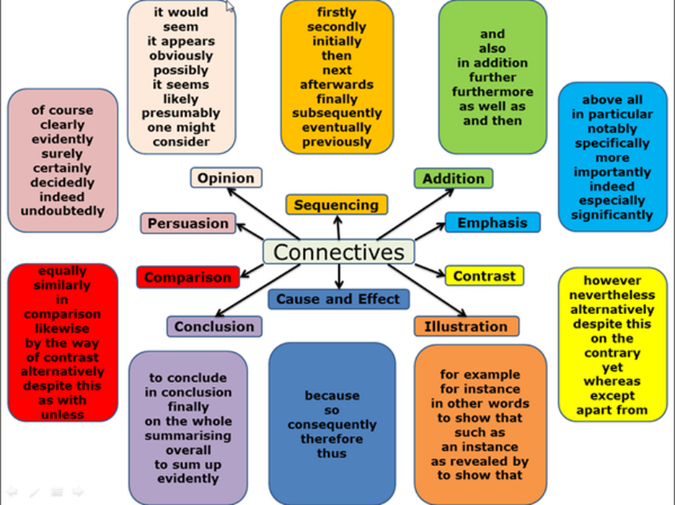
Word banks for your writing
Sentence Starters for an argument
Some people believe that…
On one hand…
It could be argued that…
Many people…
However…
Although…
On the other hand…
There is no doubt that…

Slide 17

Think about these two questions and write a balanced argument:
How has the closure of city centre offices and large numbers of staff working from home affected Cafes and small business in the centre of towns?
· How has the need for social distancing impacted restaurants, hotels and leisure centres?
Remember a balanced argument: you share both sides/ views
For/ Against
Any words you do not understand: translate in your home language

Slide 18
Edit your writing :
Features of a balanced argument
A good sentence opener
A balanced Argument
Connectives
Spelling
Punctuation
Facts

Slide 19
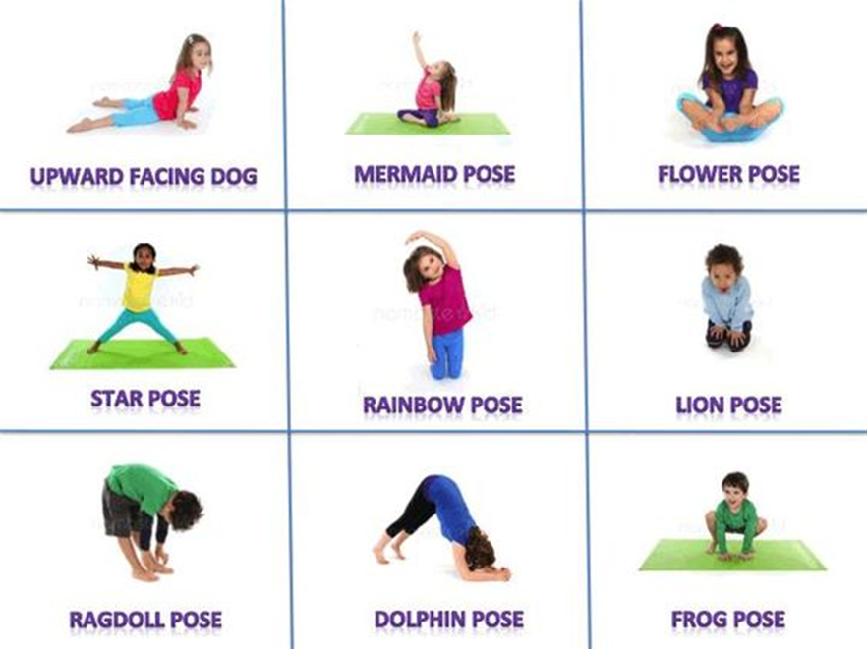
PE:
It is important to keep healthy :
Daily Run a mile
Try some of these yoga poses at home

Slide 20

Health and Wellbeing:
It is important to keep our routine. Make up a time table for these 2 days and on Friday we will share our routines in class

Slide 22

See you all Friday

