Slide 1

May 2021
Homework
Each week please complete 3 bricks (spelling, maths & reading.) Remember though you should be practicing your spelling and reading a book of your choice for at least 20 minutes every night. Over the next 4 weeks you must also complete 2 other bricks of your choice.
Make, Say, Write, Do!
.Personal Reading
Please read for at least 20 minutes each night and write down the book you are reading, author and pages you read each night.
.Personal Reading
Please read for at least 20 minutes each night and write down the book you are reading, author and pages you read each night.
Personal Reading
Please read for at least 20 minutes each night. Before continuing reading, write down a few sentences predicting the next two chapters
.
Personal Reading
Please read for at least 20 minutes each night and while reading write down new words and find their meaning/ translate to your language.
Social Studies
We are looking at natural disasters at the moment select one of the disasters that you want tl learn more information about and make a poster for our class display.
Spelling Week 2
Spelling Week 3
Spelling Week 4
Write sentences using your spelling words to demonstrate you understand the words
Write two synonyms for each of your spelling words
Practice your spelling words by creating your own word search
Numeracy
Worksheet on teams.
Worksheet on TEAMS on Monday to finish by following Monday
.
Numeracy
Worksheet on teams.
Worksheet on TEAMS on Monday to finish by following Monday
Numeracy
Worksheet on teams.
Worksheet on TEAMS on Monday to finish by following Monday
We Do Our Homwork To Make Sure We Are Prepared
R.E
May is the month of our Blessed Lady. Research why Catholics have decided to dedicate this month to Our Lady.
Maths
Worksheet on Teams.
Worksheet given on a Wednesday to bring to school the following Wednesday.
Science
Make a model at home of our solar system.

Slide 2
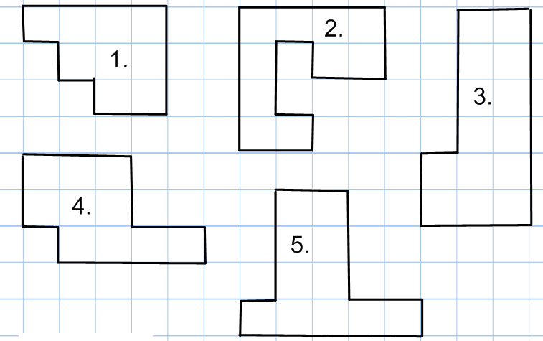
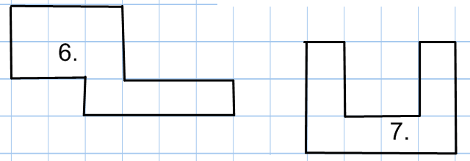
Calculate the perimeter of the following shapes
TASK A:
TASK B:
4 cm
23 m
9.4 cm
7 cm
20 m
13 m
1.9 cm
A
B
C
5 cm
15 m
3.1 cm
7.8 cm
10 cm
7 m
5.9 cm
3 cm
9 cm
8 m
6.3 cm
124 mm
14 m
12 cm
90 mm
E
2.4 m
7 cm
D
12 m
F
181mm
88 mm
3.7 m
18 cm
x cm
91mm
9.6 m
11 cm
212 mm
10.3 m
20 cm
What is the value of x ?

