Slide 1
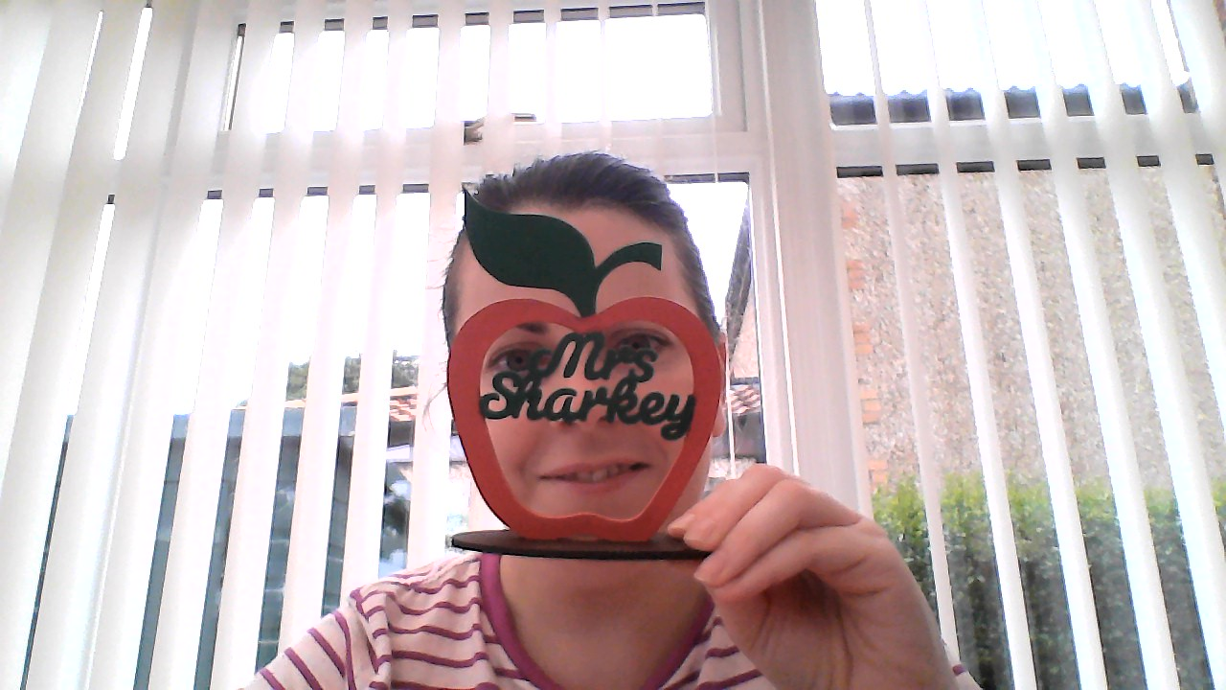
Here we are again P5.
Listen to this and sing out loud- hope is alive.
This week will focus on revision of skills we have already done to prepare us for P6.

Slide 2
P5 Home Learning. Week beginning Monday 14-06-2021
Numeracy & Maths
Do some maths and numeracy activities every day.
Log in and complete the challenges set in Sumdog. Ask me on teams if you need your password.
Task 1:
Write out you timetables 1-12 up to 12.
Spend 15 minutes each day practicing a table and ask someone to time you doing it.
    Practice makes prefect.
Task 2: Multiplication: write out in column method.
Task 3: Division: show remainers
Organising Data:
Remind yourself all about collecting data
Collect data or information about the classes favourite colour- post your on teams then
make a bar chart to show the favourite colours in P5.
Remember add a title, label the x and y lines
Colour the bars and add a key.
Mental maths practice​
1. 22, 44, 66, 88, …
2. 30, 60, 90, 120, 150, …
3. 1, 6, 11, 16, 21, …
4. 170, 160, 150, 140, 130, …
5. 20, 17, 14, 11, …
6. 30, 38, 46, 54, …
7. 21, 19, 17, 15, …
8. 50, 100, 150, 200, …
9. 250, 500, 750, 1000, …
10. 40, 100, 160, 220, …
Describe how patterns work, then write the next 5 numbers in each pattern.
Mild | Hot | Spicy
1x13 | 2x26 | 32x10
2x20 | 4x42 | 87x12
3x 43 | 6x56 | 45x81
10x8 | 10x10 | 340x10
Mild | Hot with remainders | spicy
12/2 | 29/5 | 112/11
20/4 | 62/10 | 75/4
27/9 | 55/9 | 35.2/10

Slide 3
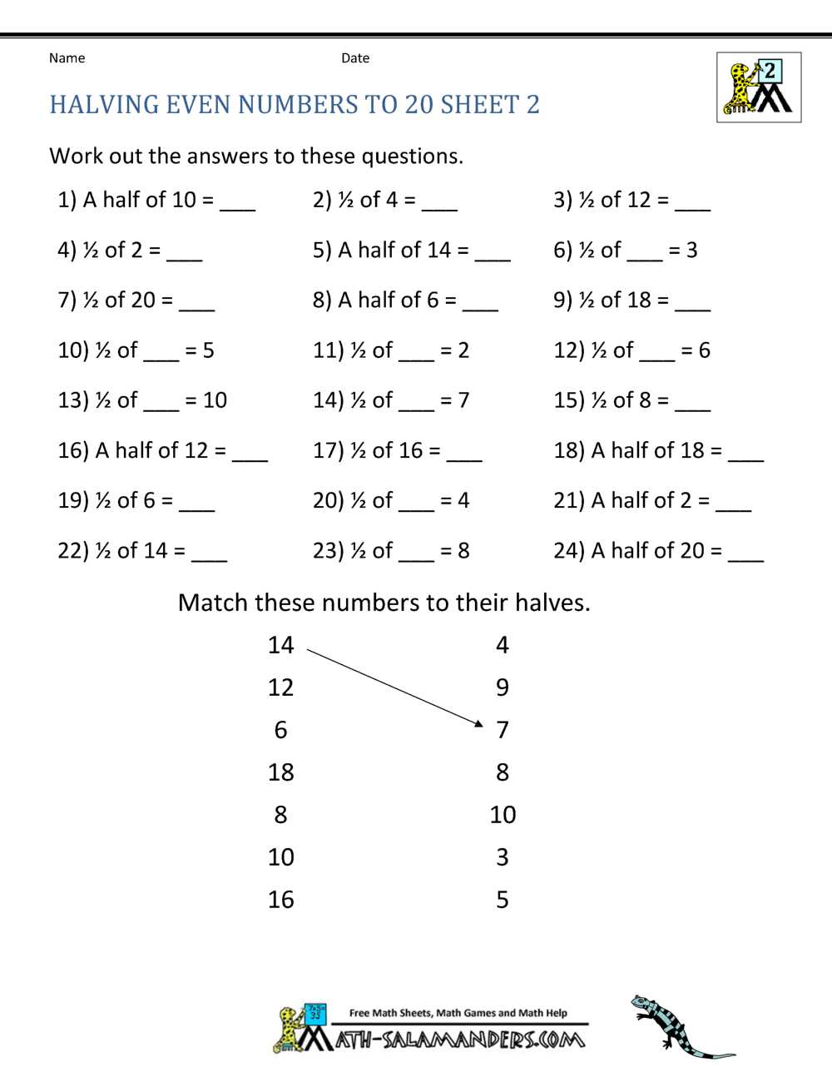

Slide 4
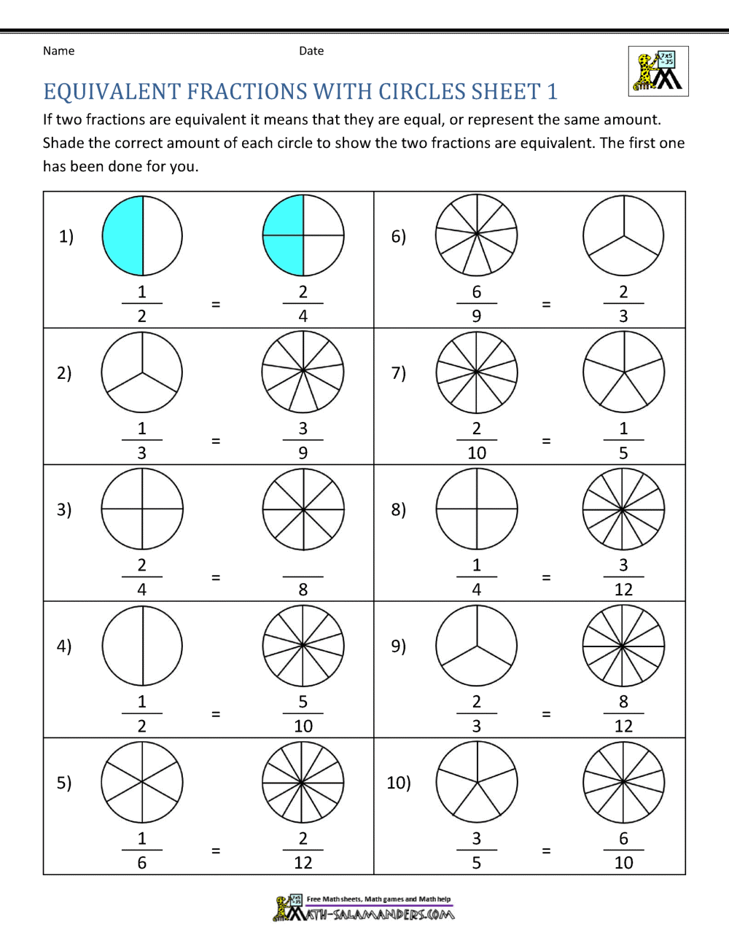

Slide 5


Literacy and English
Do some English and literacy activities every day.
Parents, if you haven’t already done it, please register for a free account on www.oxfordowl.co.uk
Reading
Read for half hour every day.
Keep telling me what you are enjoying reading.
For next week:
Register on OxfordOwl and read Viking Adventure.
Complete the Thinking Reader in Teams.
Writing
Grammar:
Write 5 sentences using
who and which
as pronouns.
2 years with Mrs Sharkey.
Planning your writing:
We already started to plan our ideas for writing about P4 and P5 with me. Write the ideas done again at home then choose 5 things you will write about at length.
You will use paragraphs:
Write the opening- who you are, what you are going to write about.
Then the next 5 paragraphs will be about one of you planning topic- Science week, Signing Silent night etc.
Write a paragraph each day and bring your work to school on Friday for editing.
Enjoy the remembering all that we have done.
Listening and Talking
Listening for information. Watch
Write down the information you hear.
Write it as a list of facts father than a story-
There are 3 owl babies.
Their names are…
Their nest is made of…
Spelling and handwriting
The apostrophe shows where a letter has been left out and if someone/thing belongs to someone.
What letter/letters are missing in the words.
Write the apostrophe in at the correct place and tell me what the long form is.
Write 5 sentence showing possession.
Im | dont | hes | well | couldnt

Slide 6



Health and Wellbeing
During lockdown how are you staying healthy?
Have you any tips that you can share with us on what helps you and your family?
Here’s what my family do:
Get up at the same time everyday.
Do some exercise that makes us smile and sing.
Eat fruit when we have it.
Go outside on bikes
Watch a family show on telly
Pray at bedtime
Read comics
Phone our family
Say sorry when we have arguments
Share what you do on teams.
R.E.​
Read this weeks Liturgy.
Gospel: Mark 4:35-41
In this reading Jesus tells the disciples not to be afraid. They should know that God is always with them, especially in the difficult times
This week out of school might feel hard for some of us, we might feel like we want to be back at school with our friends and in class learning together.
Know that we are keeping safe and we will be back at school very soon.
Task 1:
Draw a picture of a storm and put yourself in the picture, then draw a bubble around you and know that we are loved by God.
Share on teams.
P.E. ​
It is even harder to stay active when we are self isolating- but try Joe Wicks. Join me for a warm up everyday on teams.

Slide 7
Social Studies
Life for Mary Queen of Scots was very different.
Research what life was like for children in 1542 when she was born. Children who were not in the royal family!

Slide 8
Mary Queen of Scots time | Living at home | Today
 | Cooking
 | Seating
 | Family activities
 | Storing food
 | Sleeping
 | Living together
 | Looking our best

Slide 9
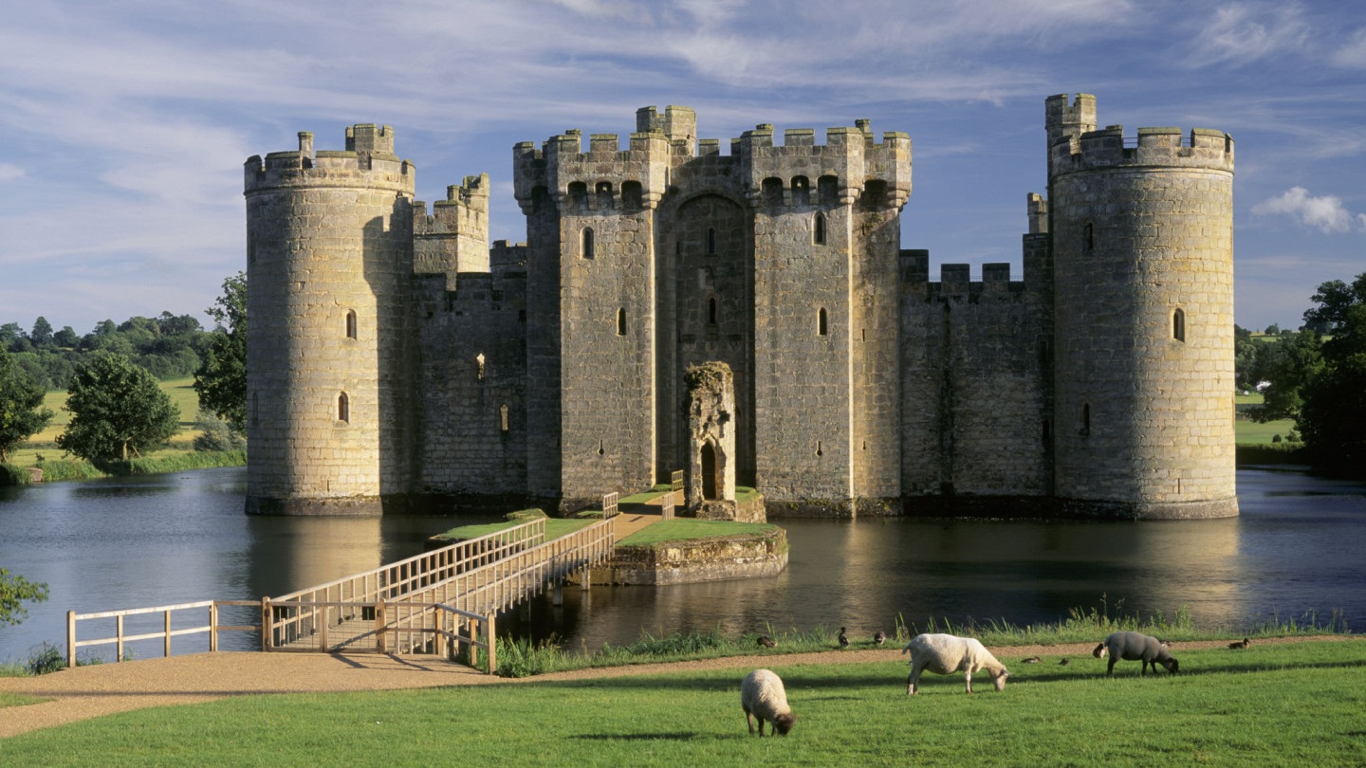

STEM
Castles-
Research castles and try to make on using recycling you have at home.
Drama
Hot Seat
Imagine you could speak to Mary Queen of Scots.
Think of 5 questions you would ask them.
If you can, get someone else in your house to ask you the questions and make a short video of your answers.
Post your video on Teams.
Modern Languages
Make a Poster in Spanish about all the different words you know in Spanish.
Check out https://www.spanish-games.net/ for more fun!

