Slide 1

November 2023 newsletter
St David’s RC Primary School

Slide 2
Contents
School Updates
Catholic Education Fortnight
Learning and Trips
Working with others
Sustainability
Parent Council
Sacrament News from St Margaret’s and St Margaret Mary’s
Important Dates for your Diary

Slide 3



School Updates
Great fun was had by all when the pantomime came to school! A wonderful afternoon of music, dance and laughter!
Our girls and boys football teams have been training and competing hard this session. They have been showing excellent teamwork and great sporting attitude. Very well done!
Miss Brownlie has been working with her ‘Rights Knights’ over the last few weeks. Exciting times ahead for St David’s as we go for our Gold Level RRS Award!

Slide 4
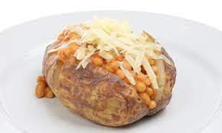
SCHool Updates
Friday Café
Baked Potatoes, Healthy Pizza, Homemade Soup
Funds raised will support P7 children with school camp.
Thanks to our INCREDIBLE volunteers!

Slide 5

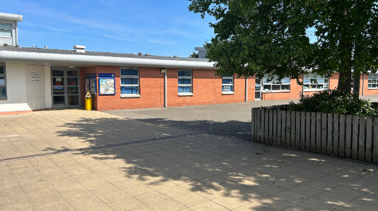
Catholic Education Fortnight
Catholic Education Fortnight begins on November 16th – Feast of St Margaret of Scotland. It ends on November 30th – Feast of St Andrew of Scotland.
Theme: Pilgrims of Faith

Slide 6

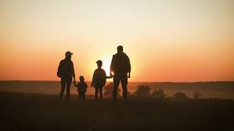

Pilgrims of Faith at St David’s RC Primary School
In our school we are Community of Faith. As a Community of Faith we gather together to pray, celebrate Mass, we learn about our faith and we try to live out our faith in the way that we treat and care for others in our community and beyond.
A person of faith believes in God and all that God has done. But faith is not simply a belief that something is true, it is a way of living. We are called not only to keep the faith but to live a faithful life filled with hope and love.

Slide 7
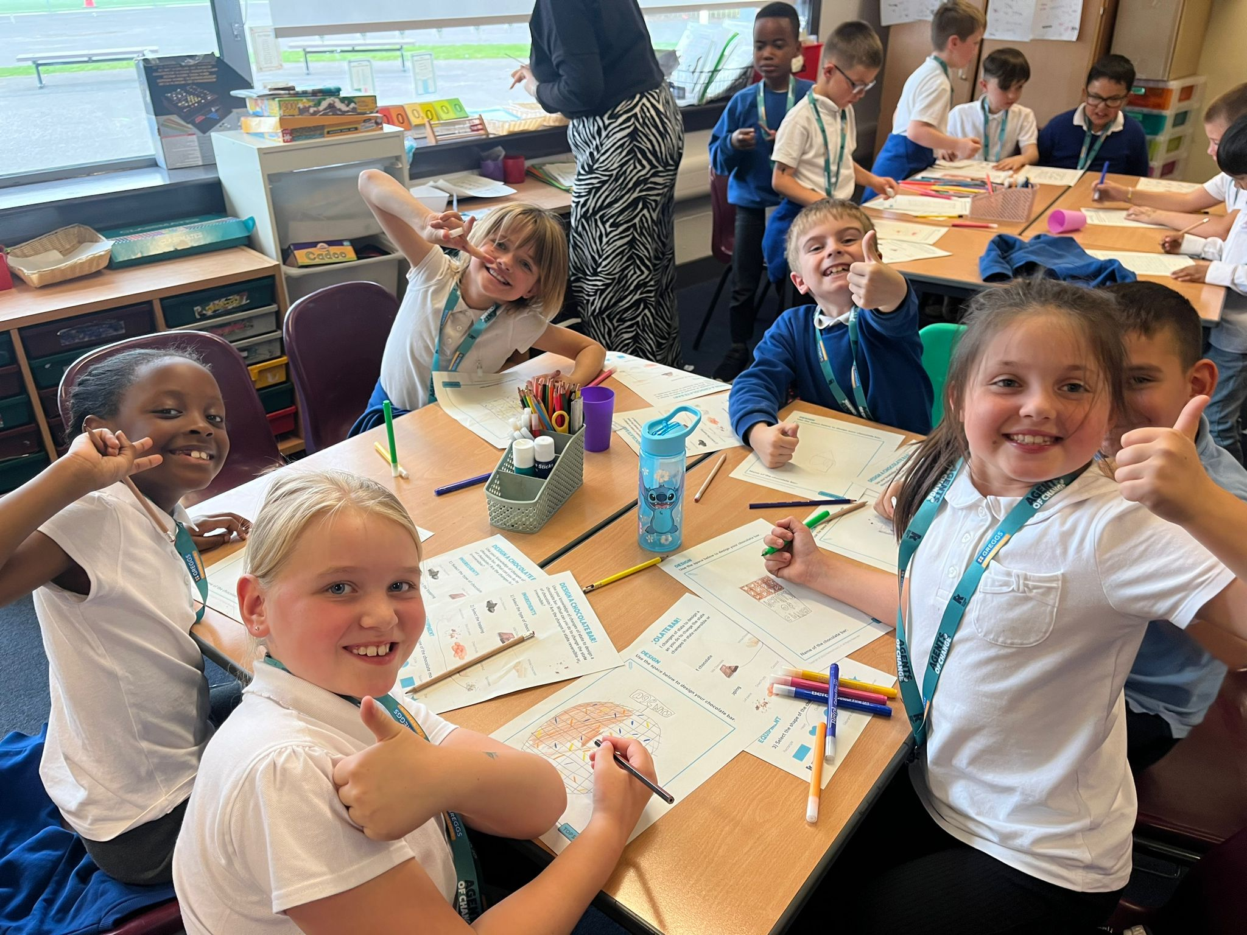
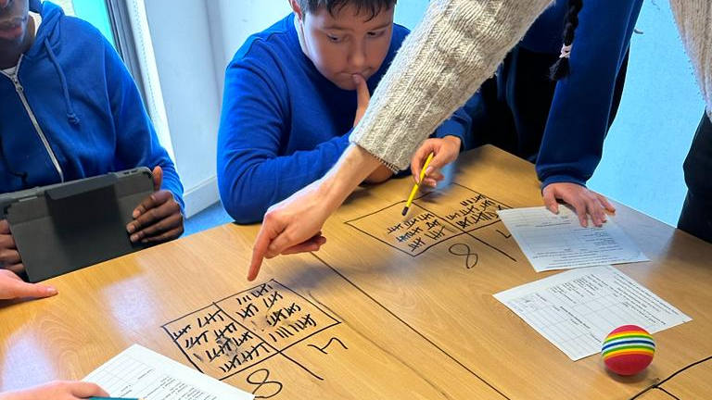
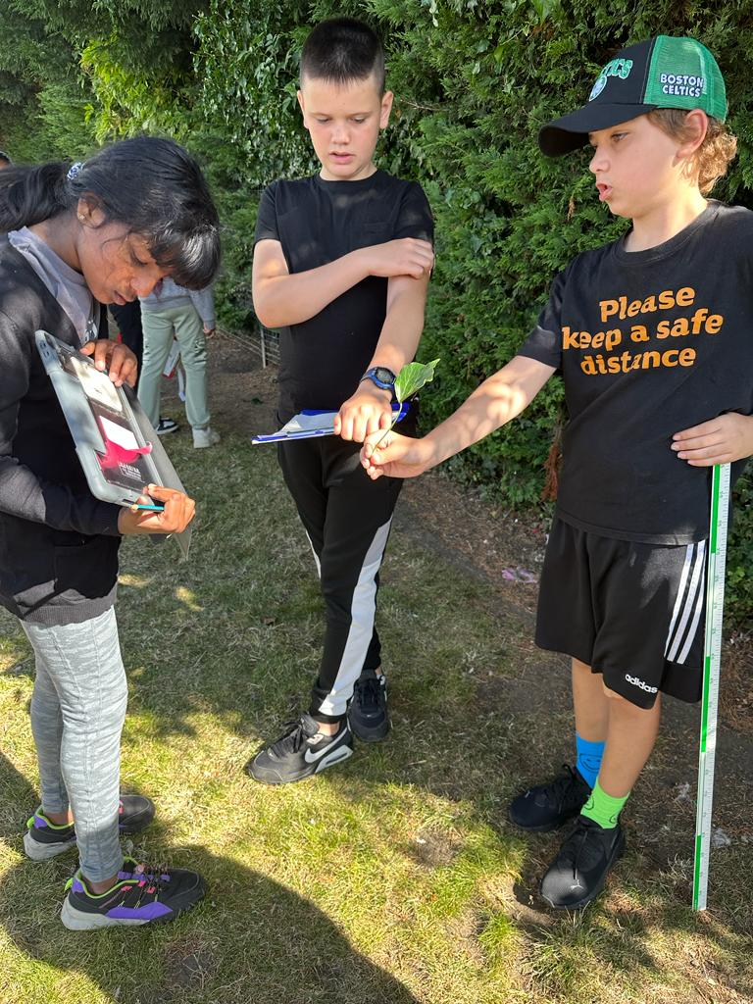
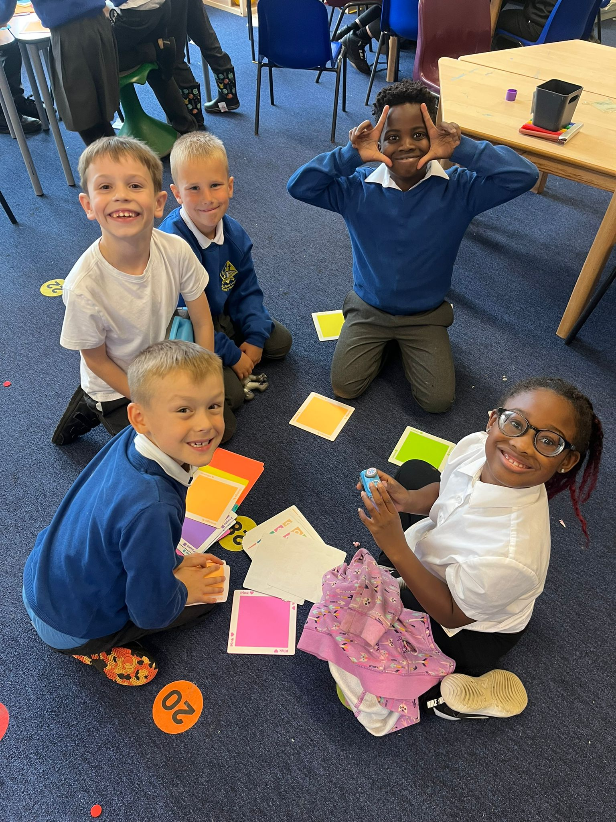
Learning at St David’s
In all classes we are working hard to ensure that learning is creative, active and relevant.
Learning takes place in the classroom and outdoors!
Being active in our learning helps us to apply our knowledge and it helps us to develop our thinking skills.
In our lessons, we are learning about careers and we are discovering what skills we need to learn for dream jobs.

Slide 8
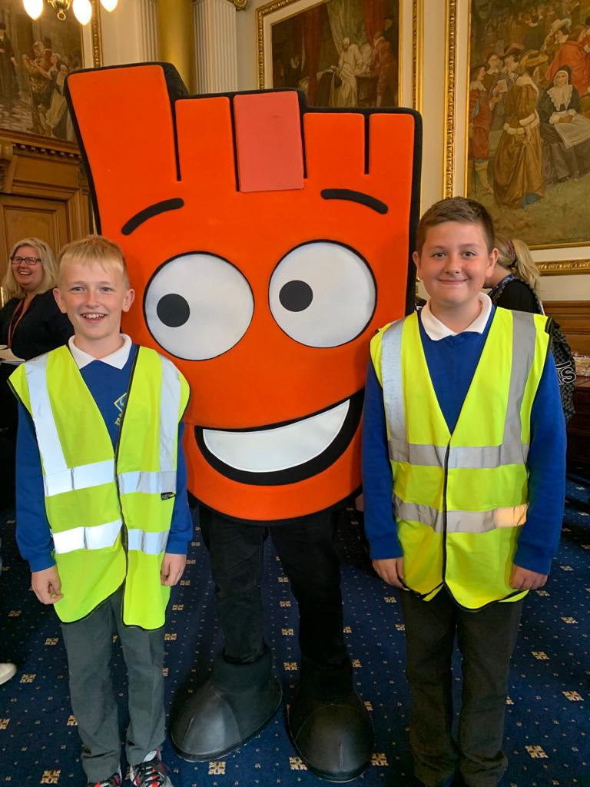
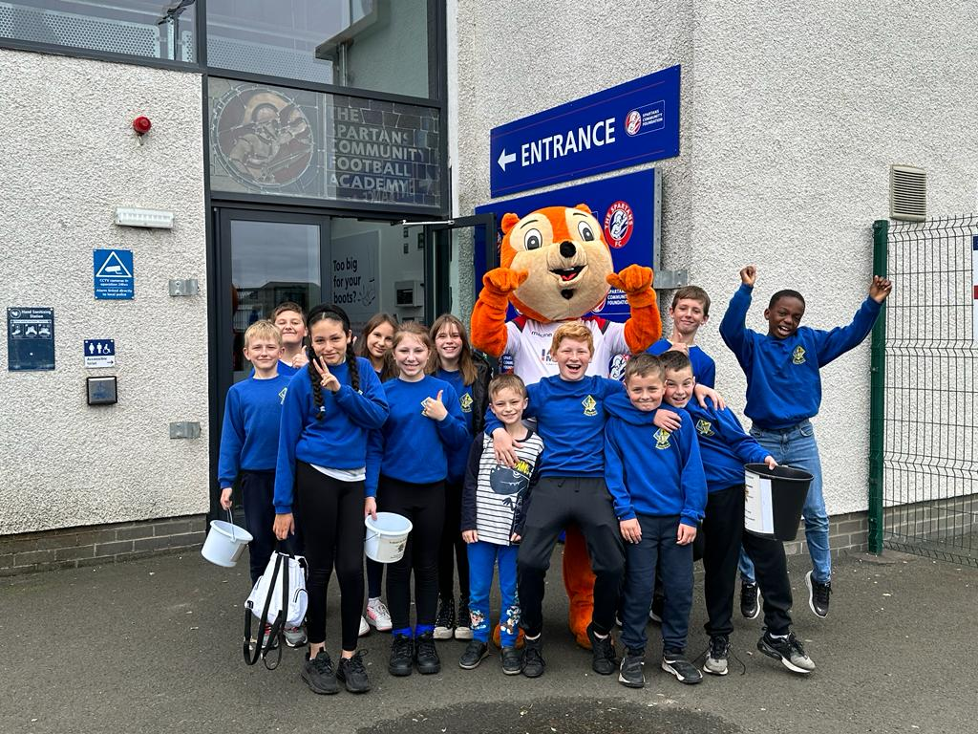
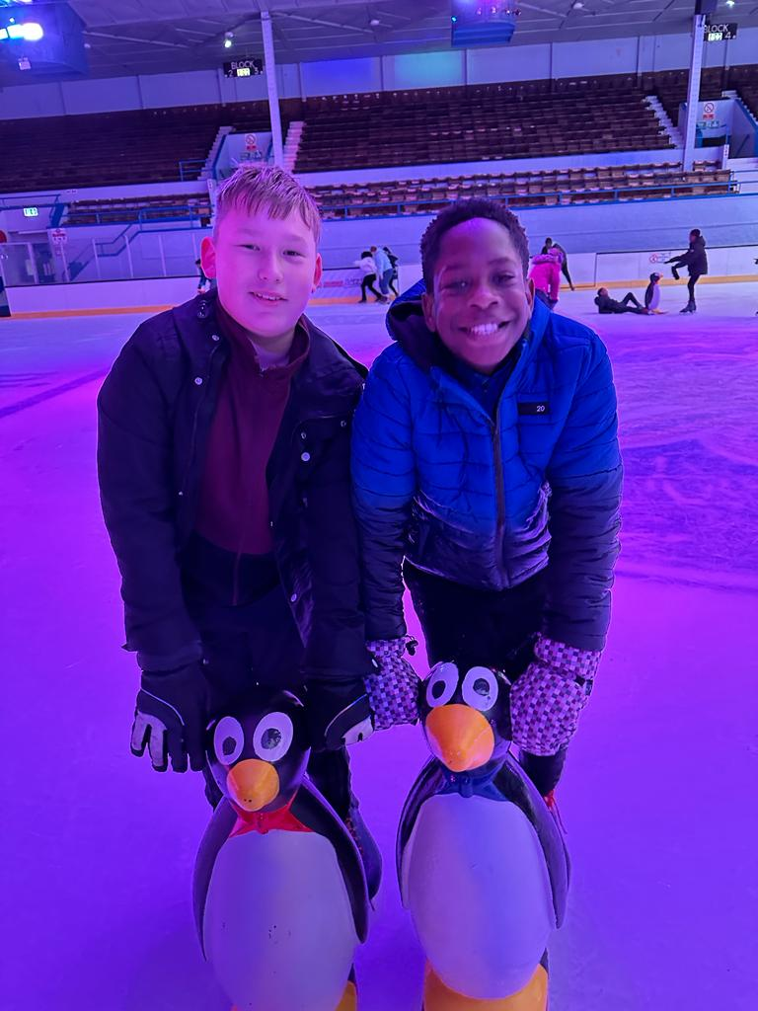
Class Trips
We are able to bring our learning to life when we take part in class trips. Trips add a great deal of excitement to our learning and they allow us to apply skills from the classroom in real life settings.
* Please ensure that you have returned your child’s KIC form and that all medical information is up to date.
* Please let your child’s teacher know if you are able to provide your support by being a class escort.

Slide 9










Working with others…

Slide 10
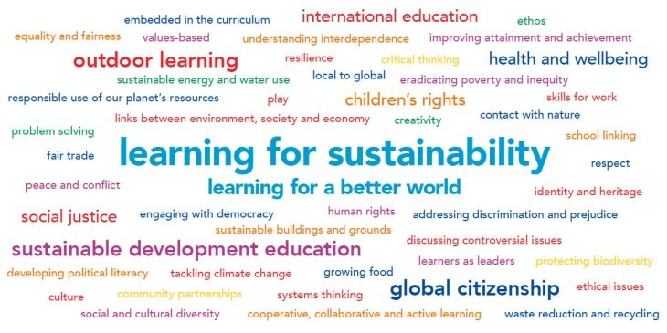
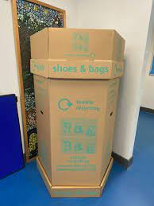
Sustainability
In school we are learning about sustainability. We want to ensure that St David’s promotes equality and justice for all.
How can you help?
If you have any wearable clothing and shoes – please bring to our clothes recycling bin in school.
We also have a second-hand uniform bank – please donate any good quality items of school uniform for others to use.
We are collecting good quality warm/outdoor clothing to support our P7s who will be attending camp in April 2024.

Slide 11


Parent Council Needs YOU!

Slide 13
Dates for your Diary
Monday | Tuesday | Wednesday | Thursday | Friday
 | 28 November | 29 November | 30 November | 1 December
 | School Photo Day Please wear uniform |  | Feast of St Andrew
4 December | 5 December | 6 December | 7 December | 8 December
Christmas Party P1 + P2 | Christmas Party P3/2 + P3 | Christmas Party P5a + P5b | Christmas Party P4a + P4b
11 December | 12 December | 13 December | 14 December | 15 December
Choir to Ocean Terminal |  | P1 Nativity performance to school | P1 Nativity Parents 1.30pm | Christmas Fair 1pm – 2.30pm School Hall
18 December | 19 December | 20 December | 21 December | 22 December
Christmas Party P6a + P6b | Christmas Dinner Christmas Party P7a + 7b |  |  | Last day of term! Happy Christmas! All return: January 9

Slide 14
Catholic Education Week Prayer
Jesus our Teacher,
In your love for us, help us to develop our own talents
so that we may become like you,
and lead lives of goodness.
Bless all learners and all teachers.
May our Catholic schools continue to serve our families,
our communities and our country.
Help us, through our learning, to believe in you,
and to celebrate the life of your Church.
Help us to grow in holiness
as we grow in friendship with you,
and try to become saints.
We make this prayer in the name of Jesus, our Lord. Amen

