Slide 1


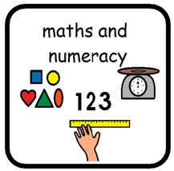
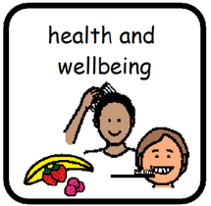

This term we are focusing on…
Sound recognition (set 1 and 2)
Reading and writing CVC independently
Building a simple sentence.
Creating a short story sequence (the story mountain.
Creating small narrative stories.
This term we are focusing on…
Number recognition to 30
Addition and Subtraction
Coin recognition, adding and subtraction with coins (1p and 2p) to make small amounts.
Recognising fractions (halves and quarters)
Primary 1
Term 3
This term we are focusing on…
building skills for emotional regulation, during challenging times.
Assessing risks and learning to travel safely when taking part in physical activities,
Exploring our rights and how to exercise them.
This term we are focusing on…
People who help us and the emergency services…
The human body and living things.
Our senses and exploring them in our environment.

