Slide 1


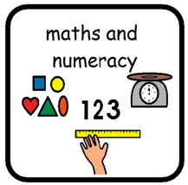
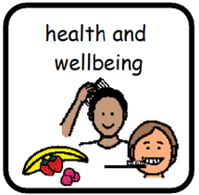

Reading:
-To learn set sounds and incorporate them into words for word blending.
-To Spell words with set sounds.
- To read with fluency and confidence.
Writing:
- To write an information report.
-To take notes, looking out for key words.
-To create and link titles.
-To use adjectives.
Listening and Talking:
-To ask questions.
-To use key vocab in conversation.
-Playing team games to build friendship and teamwork skills.
-Playing strategy games to develop thinking skills.
-To learn about the importance of sleep to look after our wellbeing.
-To learn about how healthy food helps our physical and mental
wellbeing,
-To explore the effects exercise has on our wellbeing.
Numeracy:
-To subtract using different strategies including pictorial, number line, 10 frames and tower sums.
- To count forwards and backwards to 100
-To skip count.
Maths:
Money:
-To identify coins/ values.
-To add cost of coins/ prices.
-To find change.
Shape:
-To identify 2D/3D shapes.
-To identify properties of 2D/ 3D shapes.
Primary 2
Term 3
The body:
-To name and identify different parts of the body (skeleton, lungs, nose, ears, eyes, mouth, skin) .
-To identify the function of different parts of the body (skeleton, lungs, nose, ears, eyes, mouth, skin) .
-To identify and explore our senses (smell, taste, sight, touch, hearing).
-To discover how to keep our bodies and minds healthy (exercise, sleep, healthy food).

