Slide 1

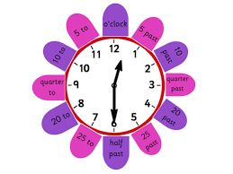



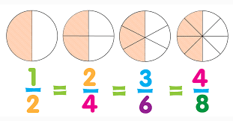



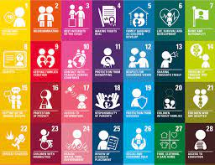
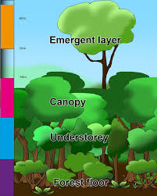
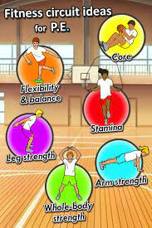
Reading
Reciprocal reading – We are learning
how to use skills in predicting, clarifying and summarising.
We will be learning to develop our comprehension
skills.
Writing
We will be using ‘Colourful Semantics’
to build sentences and stories.
We will be using persuasive language to
create letters and posters.
Listening and Talking
Note taking and discussions.
Creating video advertisements using
persuasive language.
Wider Maths
We will be learning about
Time
.
- O’ Clock.
- Half past.
- Quarter past/ Quarter to.
-Analogue and Digital clocks.
-5 minute intervals.
Fractions
-Fraction of a number
-Fraction of a shape
-Comparing fractions
Number Process
Multiplication
Division
Problem Solving
Primary 4
Term 3
Health and Wellbeing
We are learning about where living
things come from and about how they grow, develop and are nurtured.
RRS and Global Goals
We will continue to learn about our Rights and link these to our Global Goals.
PE
We are leaning to improve our fitness and performance through fitness stations.
RE
Preparing for our First Holy Communion.
Laudato Si
Spanish
We are learning about:
-animals.
- our family.
The Rainforest
We are learning about:
The layers
Habitats
Animals
Deforestation

