Slide 1


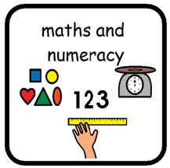


Number and number processes:
Multiplying and dividing two digit, three digit and
four digit number using a range of strategies
including finding multiples and factors.
Fractions, decimals and percentages
Solving problems using fractions, decimals and percentages. This may include converting
between decimals and fractions, as well as
adding and multiplying fractions and decimals.
Time
Reading clocks, calculating durations of time, and carrying out time related practical tasks.
Descriptive writing: Using metaphors, similes, adjectives and adverbs to describe a place they have visited.
Reading with fluency and understanding
Reading and analysing a text in groups with a focus on the style of writing e.g. genre, use of adjectives, metaphors etc
Spelling: Using spelling patterns to improve confidence in phonetical awareness.
Primary 6
Term 3
Social wellbeing: Our focus is on applying our school values (HEART) and learner dispositions (MIND) in and outside the classroom.
We have been learning about the work of the UNCHR and we are learning about how to protect these rights for everyone.
Physical Education, Physical Activity & Sport: Movement skills, competence and confidence, cooperation & competition and evaluation and appreciating.
Scottish Wildlife: We are learning to identify different animal and plant species as well as learning about food chains and eco-systems. There will be a focus on conservation.
John Muir Award: We are working towards our Explorer award this academic year and will be undertaking a lot of outdoor learning including some trips to local areas of natural beauty.

